Slide 1
Digital simulations & metacognition
Paul Maharg
Osgoode Professional Development
Manchester Met Law School

Slide 2
preview of…
Two examples:
  Personal Injury (PI) sim transaction
  Ardcalloch Legal Information & Advice Service (ALIAS) – students writing a professional web newsletter for clients.

Slide 3
Why digital sims + metacognition?

Slide 4
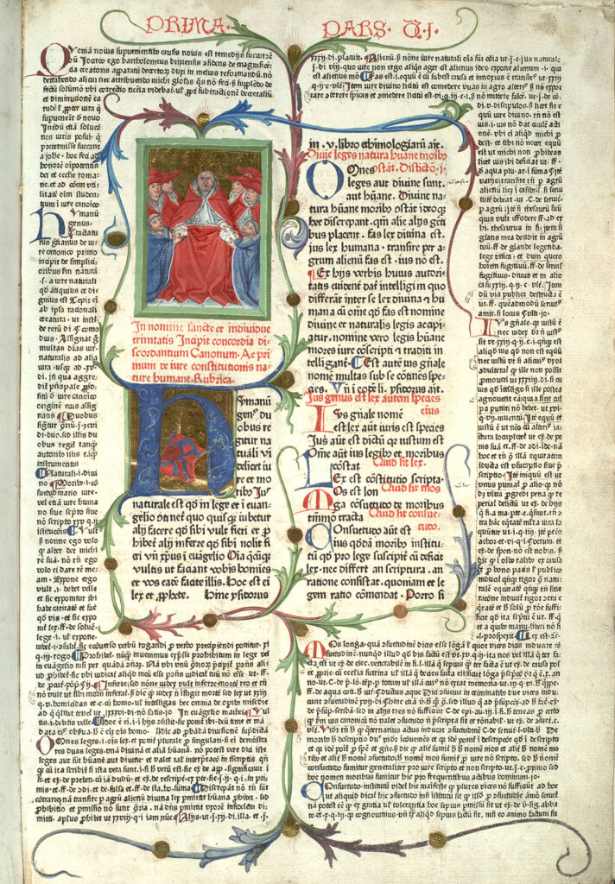
curriculum is technology
Curriculum is multiple distributed technologies and practices. Eg timetables, course teams, notepads, learning spaces, forms of knowledge transmission, discussion, computers, forms of discourse, writing – all existing in time spans.
Some technologies are ancient (lectura, glossa), some new (SIMple, simulated clients, mobile phones)
Success in learning means:
  for staff, the need to
  compose and orchestrate the curriculum.
  for students, the tools, support & spaces to
  manage their own curriculum
University of Edinburgh Digital Image Collections. CC BY-NC-ND 3.0

Slide 5
SIMple simulations…
Are close to the world of practice, but safe from the (possible) realities of malpractice and negligent representation.
Enable students to practise legal transactions, discuss the transactions with other tutors, students, and use a variety of instruments or tools, online or textual, to help them understand the nature and consequences of their actions
Facilitate a wide variety of assessment, from high-stakes assignments with automatic fail points, to coursework that can double as a learning zone and an assessment assignment
Encourage collaborative learning. The academy often prizes singleton, solitary work; the world prizes collaboration, teams, delegation, leadership, agility, resilience, metacognition
Students begin to see the potential for communications; and that technology is not merely a matter of word-processed essays & quizzes, but a form of learning that changes quite fundamentally what and how they learn.

Slide 6
…sims that can be based on transactional + metacognitive learning
A specific form of problem-based learning. At least seven distinguishing elements –
active learning
through performance in authentic transactions
involving reflection in & on learning,
deep collaborative learning, and
holistic or process learning,
with relevant professional assessment
that includes ethical standards
– that can have a significant effect on learning when used in simulations of professional practice.
We use a sim platform called SIMple (SIMulated Professional Learning Environment)

Slide 7
SIMple: an example of a sim platform for Law

Slide 8
    SIMple is a platform for creating simulations of legal practice
Two parts:
Case-based management tools for:
  Multiplayer or singleton simulations, including fictional characters
  Teams of students can work in a virtual law firm and work through one or more matters
  Specific timelines, typically three to four days or weeks, with activities occurring most days.
  Students representing different parties in a case
Sim engine that will:
  Assist staff to design, create, test, run, archive sims
  Offer different types of assessment including reflection tools
  Assist with the administration of sims, eg formation of virtual law firms, assessment results, etc
Currently, sims running in Osgoode Hall Law School, Osgoode Professional Development, Manchester Met Law School.

Slide 9
student page functions (overview)
Transaction Matter Main Page
The transaction matter main page consists of a list of tasks, inbox items, messages sent, documents, and conversations. Students navigate to other items from this main page.
Transaction Matter Conversation
Conversations include messages, comments, and replies. Students can create comments, reply to comments, and edit or delete comments.
Firm Calendar / Task Manager Overview
The firm calendar/task manager overview contains a list of firm tasks by date. Students can also link to view tasks or update and create tasks from this page.
View and Update Tasks
Viewing and updating tasks show the task name and task description and allow students to change the assignee and the due date for the task. Students are also able to add both attachments and comments.

Slide 10
supervisor/facilitator page functions (overview)
List of Firms and Matters
This page shows the complete list of firms and matters for the tutor to select and enter the firm view for a particular team of students.
Firm View
The firm view includes a timeline of the firm, a summary of activity, and a conversation summary. Tutors can click on the conversation summary link to reply to a conversation.
Firm Calendar / Task Manager Overview
The firm calendar/task manager overview lists firm tasks by date. Tutors can also link to view tasks or update and create tasks from this page.
View and Update Tasks
View and update tasks will show the task name and task description and allow tutors to change the assignee and the due date for the task. Tutors will also be able to add both attachments and comments.

Slide 11
Two examples of sims:
Personal Injury transaction
&
ALIAS

Slide 12
Example 1: personal injury negotiation project
Diploma in Professional Legal Practice
Glasgow Graduate School of Law (2000-2014)
Assessment outcomes
Students in firms of four were required to:
  complete the PI transaction on behalf of their client
  write a reflective report collectively on the experience
We required from each student firm a case file body of evidence to specified standards, consisting of:
  fact-finding – from information, documents, fictional characters
  professional legal research – using LN + paperworld sources
  formation of negotiation strategy – extending range of earlier learnings
  performance of strategy – correspondence + optional f2f meeting, recorded

Slide 13
course structure
272 students, 68 virtual firms of four students in each, 8 anonymous information sources – SIMs – Sim Information Managers, playing around 12 fictional characters
68 document sets, 34 transactions, based on same narrative
Each scenario had embedded variables, called from a document server, making it similar, but also unique in critical ways
students had 12 weeks to achieve settlement
introductory & feedback lectures
discussion forums
FAQs & transaction guideline flowcharts; suggested reading
voluntary face-to-face surgeries with a PI solicitor
No other academic or professional resource structures

Slide 14
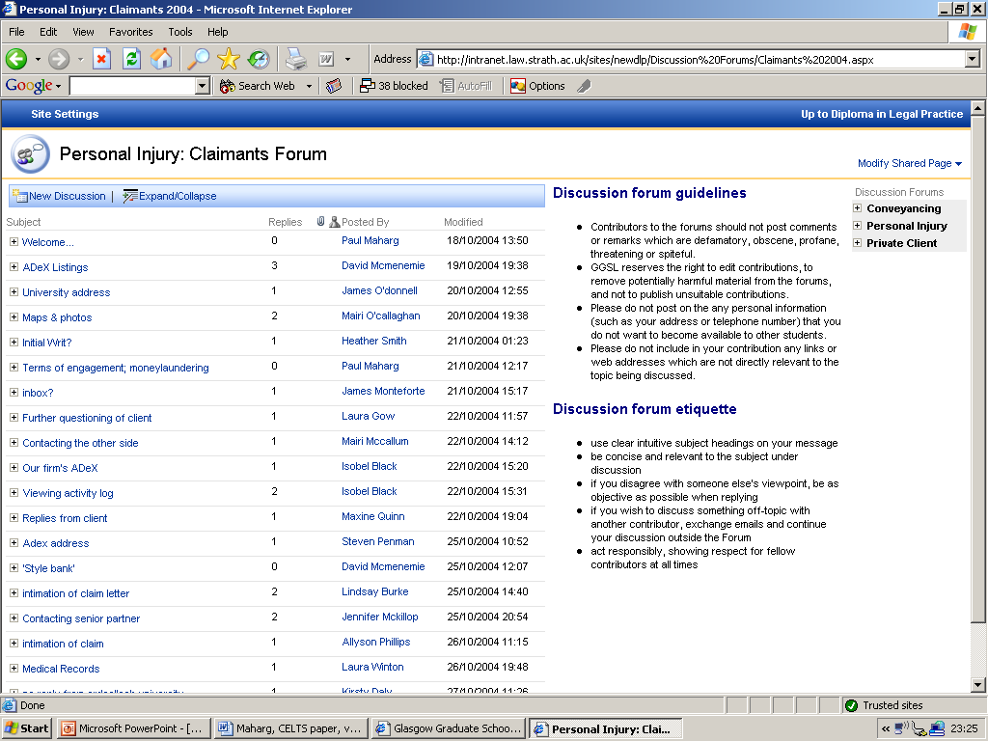

Slide 15
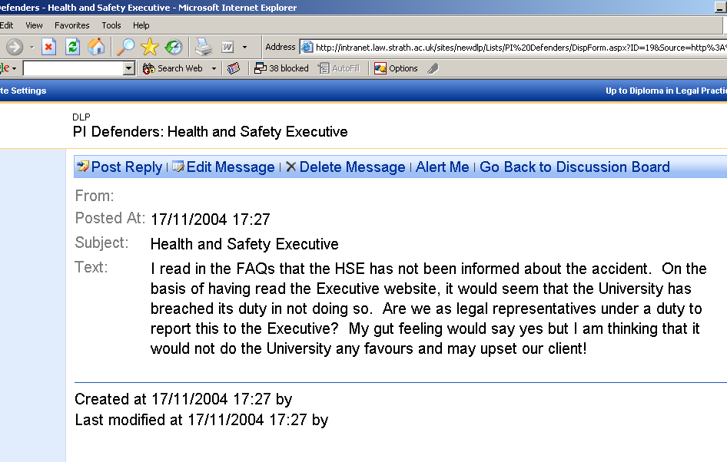

Slide 16
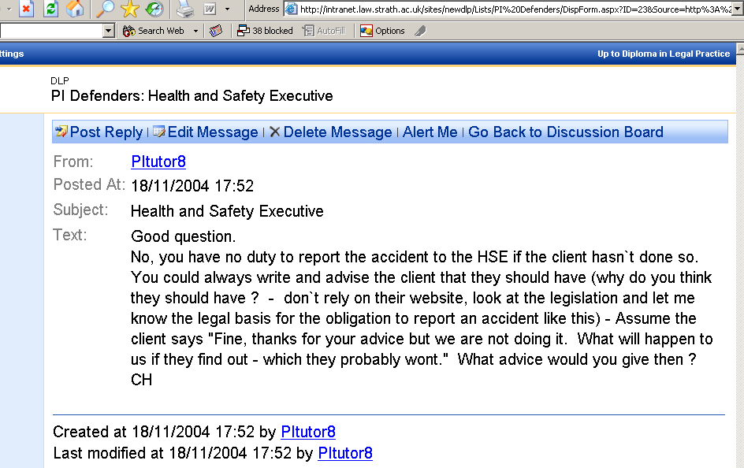

Slide 17
PI project: (some of) what students learned – all of it types of metacognition, esp bold items
extended team working
real legal fact-finding
real legal research
process thinking in the transaction
setting out negotiation strategies in the context of (un)known information
writing to specific audiences
handling project alongside other work commitments
structuring the argument of a case from start to finish
keeping cool in face-to-face negotiations
more effective delegation
keeping files
taking notes on the process...

Slide 18
PI project: what students would have done differently…
(my emphases)
‘In tackling this project I think that our group made two main mistakes. The first mistake we made was in approaching the task as law students as opposed to lawyers. By this I mean we tried to find the answer and work our way back. Immediately we were thinking about claims and quantum and blame. I don't think we actually initiated a claim until a week before the final settlement. I think the phrase "like a bull in a china shop" would aptly describe the way we approached the problem. […] Our group knew what area of law and tests to apply yet we ended up often being ahead of ourselves and having to back-pedal.
The second mistake we made was estimating how long it would take to gather information. We started our project quite late on and began to run out of time towards the end. None of us appreciated the length of time it would take to gather information and on top of this we would often have to write two or three letters to the same person as the initial letter would not ask the right question.’

Slide 19
PI project: what students would have done differently…
(my emphases)
‘At the beginning we thought we perhaps lost sight of the fact that we had a client whom we had a duty to advise and inform. On reflection we should have issued terms of engagement and advised the client better in monetary terms what the likely outcome was going to be.’
‘[…] unlike other group projects I was involved in at undergraduate level I feel that I derived genuine benefit from this exercise in several ways:
  reinforcing letter-writing, negotiation, time-management and IT skills
  conducting legal research into issues of quantum
  working effectively in a group as a group - not delegating tasks at the first meeting and then putting together pieces of work at the second meeting.’

Slide 20
Example 2: Digital sims, legal writing & metacognition…
OCCLUDED GENRES
‘Academic occluded genres are, in part, those which support the research publication process but are not themselves part of the research record.’
Swales (1996, 45 – see also Swales & Feak, 2004)
Examples in the academy:
    Request letters (for data, copies of papers, advice, etc)
    Application letters (for jobs, scholarships, etc)
    Submission letters (accompanying articles, books, etc)
    Research proposals (for outside funding, etc)
    Recommendation letters (for students, job seekers, etc)
The professional field is full of similar occluded genres - some of them, eg web writing for clients, new forms of digital writing.
Genre activity is full of metacognitive activity: recognize it, choose it, how to write it, for whom, sense of audience, creating writer-centred prose, etc.

Slide 21
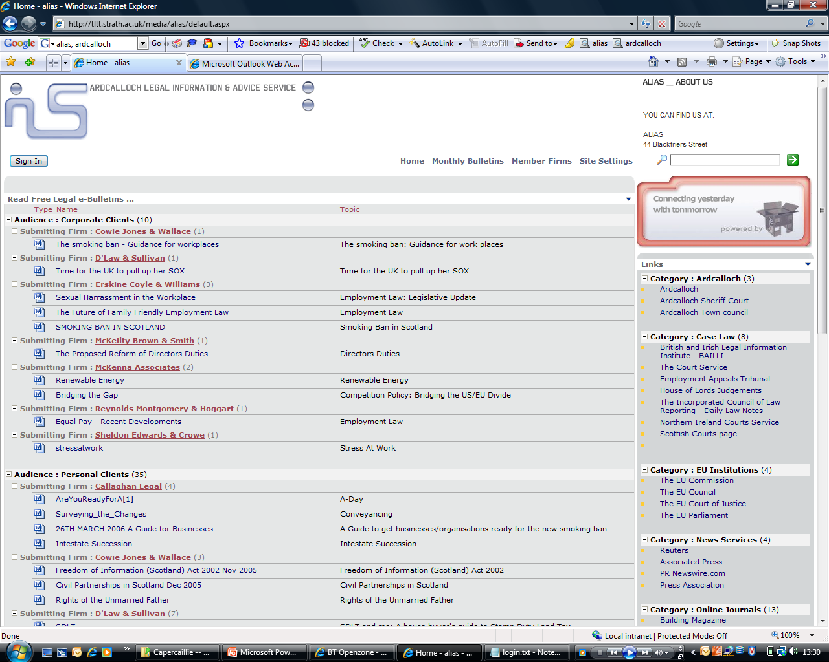
client bulletins on the web, via a community wiki…
ALIAS –
Ardcalloch
Legal
Information & Advice
Service

Slide 22
... developed as a professional collaborative writing environment
We created a Mediawiki, called ALIAS – Ardcalloch Legal Information and Advice Service
Students were required to write at least two bulletins each, c.500w max.
They could:
  see each other’s drafts in their firms (collaborative learning)
  amend firm’s drafts (collaborative working) then upload
  Be responsible for individual articles (ownership…)
Staff could:
  see student drafts (observe collab. learning + working)
  comment on drafts (feedback on individual work)

Slide 23
how I developed the project – my metacognitive activity
Date | Design work
2003/04 | I had a sense of professional legal writing for the web as an ‘occluded genre’ that students needed to know about and practise as a future professional literacy.
2005 | Designed the tasks; LTDU created the wiki environment; we used the infrastructure of the virtual firm. I wrote student guidelines as to form & genre of writing + project admin. First run of the sim.
2005 | Poor results! Students wrote highly-compressed 2,000-word academic essays complete with f/notes, case & stat refs, etc. Little sense of audience or purpose.
2005/6 | Brought in a PSL + web editor from McGrigors law firm to present to students on their work for the firm on client bulletins – students loved their work. Big improvement in student work in that and subsequent years.
2006 & ff. | Asked PSL & web editor to webcast their presentation for future students. Resources included professional legal writers as well as GGSL staff, and used previous student work & previous students as guides & mentors.

Slide 24
Further information

Slide 25
further information
Maharg, P. (2007). Transforming Legal Education: Learning and Teaching the Law in the Early Twenty-First Century, Ashgate Publishing, Aldershot.
Barton, K., McKellar, P., Maharg, P. (2007). Authentic fictions: simulation, professionalism and legal learning, Clinical Law Review, 14, 1, 143-93
Barton, K., Maharg, P. (2006) Simulations in the wild: interdisciplinary research, design and implementation, in Games and Simulations in Online Learning, edited by Aldrich, C., Gibson, D., Prensky, M, Idea Group Ltd, Hershey, PA, 115-148
Barton, K & Westwood F. (2006). From student to trainee practitioner – a study of team working as a learning experience, Web Journal of Current Legal Issues, http://webjcli.ncl.ac.uk/2006/issue3/barton-westwood3.html
de Freitas, S., Maharg, P., eds (2011). Digital Games and Learning, Continuum Publishing, London.
Maharg, P. (2012). Assessing legal professionalism in simulations: the case of SIMPLE, in Cerillo, A., Delgado, A.M., eds, La Innovacion en La Docencia del Derecho a Traves del USO de las TIC. Universitat Oberta de Catalunya, Barcelona.
Maharg, P., Owen, M. (2007). Simulations, learning and the metaverse: changing cultures in legal education, Journal of Information, Law, Technology. Special Issue on law, education, technology, 1, http://www2.warwick.ac.uk/fac/soc/law/elj/jilt/2007_1/maharg_owen
Maharg, P. (2017). The Gordian knot: regulatory relationship and legal education. Asian Journal of Legal Education, 4, 2, 79-94. https://journals.sagepub.com/doi/abs/10.1177/2322005817700185
Swales, J. (1996). Occluded genres in the academy: the case of submission letters. In Academic Writing: Intercultural and Textual Issues, Eija Ventola, Anna Mauranen, eds, John Benjamins Publishing, New York, 46-58.
Swales, J., Feak C. (2004). Academic Writing for Graduate Students. Essential Tasks and Skills. Second edition, University of Michigan Press.

Slide 26
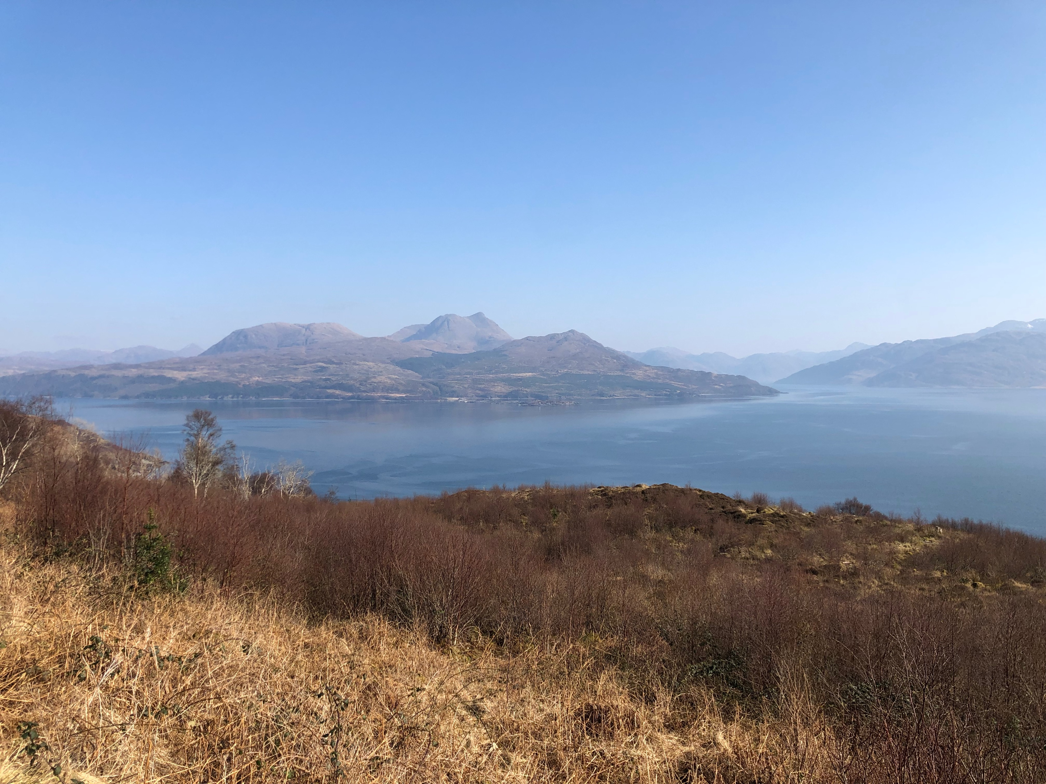
Email: pmaharg@osgoode.york.ca
Web: https://paulmaharg.com

