Slide 1
Simulated clients: situated theory & practices
Professor Paul Maharg OsgoodePD Manchester Met Law School https://paulmaharg.com/

Slide 2
preview
The Simulated Client Initiative (SCI) – why, origins, current projects
Training SCs
The SCI in Canada – some examples
Future projects
Final thoughts

Slide 3
The Simulated Client Initiative (SCI) – why, origins, current projects, studies

Slide 4
why SCs?
In substantive courses, students often learn about legal problem solving in fragmented steps
Students seldom practise these steps in real time with real people to solve real problems.
Above all, it enables students to find their voice, professionally, relationally and ethically.
Interviewing SCs introduces students to lawyer-client relationship dynamics and the fusion of practical information-gathering with legal analysis. SC scenarios range from ‘personal plight’ to commercial law and business transactions

Slide 5
SCs - origins
Strathclyde University, 2005, pilot project (partners Georgia State University College of Law, Dundee University Medical Faculty)
Used model from medical profession of Simulated Patients (SPs), non-lawyers were trained to be Simulated Clients (SCs)
Our study proved SCs assessed important aspects of client interviewing with better validity and reliability than law tutors
SCs evaluate those aspects of the interview that can be assessed by non-lawyers
Made what client thinks important the most salient for the student: the interview grade is given by the client
This has changed how we enable students, trainees and lawyers to learn interviewing & client-facing ethical behaviour

Slide 6
current status of SCI projects
University of Strathclyde Law School (Glasgow, Scotland) | WS (Writers to the Signet Society) (Edinburgh, Scotland)
University of New Hampshire Law School (Concord, NH, USA) | The Australian National University College of Law (Canberra, ACT, Australia)
Northumbria University Law School (Newcastle, England) | Kwansei Gakuin University Law School (Osaka, Japan)
Hong Kong University Faculty of Law (Hong Kong) | The Chinese University of Hong Kong (Hong Kong)
Nottingham Trent University Law School (Nottingham, England) | Newcastle University Law School (Newcastle, England)
Osgoode Hall Law School/ OPD (Toronto, ON, CA) | University of Windsor Faculty of Law (Windsor, ON, CA)
Flinders Law School (Adelaide, SA, Australia | Solicitors Regulation Authority (London, England)
Canadian Centre for Professional Legal Education (CPLED: includes regulators from the provinces of AB, MB, SK, NS, Nunavut & BC) | Law Society of Ireland (Dublin, Ireland)
National Centre for Skills in Social Care (London, England) | Manchester Met U Law School (Manchester, England)

Slide 7
current status of SCI projects
University of Strathclyde Law School (Glasgow, Scotland) | WS (Writers to the Signet Society) (Edinburgh, Scotland)
University of New Hampshire Law School (Concord, NH, USA) | The Australian National University College of Law (Canberra, ACT, Australia)
Northumbria University Law School (Newcastle, England) | Kwansei Gakuin University Law School (Osaka, Japan)
Hong Kong University Faculty of Law (Hong Kong) | The Chinese University of Hong Kong (Hong Kong)
Nottingham Trent University Law School (Nottingham, England) | Newcastle University Law School (Newcastle, England)
Osgoode Hall Law School/ OPD (Toronto, ON, CA) | University of Windsor Faculty of Law (Windsor, ON, CA)
Flinders Law School (Adelaide, SA, Australia | Solicitors Regulation Authority (London, England)
Canadian Centre for Professional Legal Education (CPLED: includes regulators from the provinces of AB, MB, SK, NS, Nunavut & BC) | Law Society of Ireland (Dublin, Ireland)
National Centre for Skills in Social Care (London, England) | Manchester Met U Law School (Manchester, England)

Slide 8
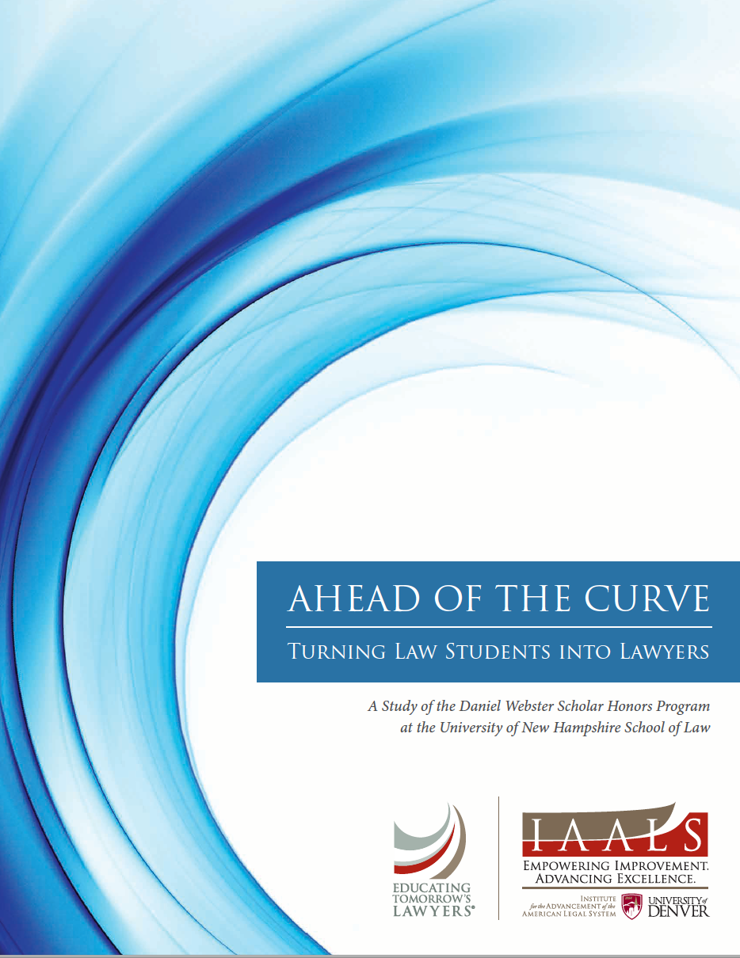
independent study of UNH Law School’s Bar exemption course…
In focus groups, members of the profession and alumni said they believe that students who graduate from the program are a step ahead of new law school graduates;
When evaluated based on simulated client interviews, students in the program outperformed lawyers who had been admitted to practice within the last two years;
The only significant predictor of simulated client interview performance was whether or not the interviewer participated in the Daniel Webster Scholar Honors Program. Neither LSAT scores nor class rank was significantly predictive of interview performance.
Gerkman, A., Harman, E., Bond, L., Sullivan, .M. (2015). Ahead of the Curve: Turning Law Students into Lawyers. A Study of the Daniel Webster Honors Program. IAALS, Denver.

Slide 9
Training SCs

Slide 10
three-day programme: SC training day 1 - script conference
introduction to the method; discussion of roles
read scenario script as a group
discuss roles, bias and unconscious bias
discuss SCs’ feelings, reactions; we amend the script
clear up ambiguities re role of lawyer
facilitator uses SC feedback to modify the scenario

Slide 11
SC training day 2: practising the role
SCs calibrate:
Body language
Tone of voice
Attitudinal swings
Dealing with the lawyer’s open questions…
Improvising on the lawyer’s closed questions…
Performance analysis on video review: ‘What prompted you to say…?’ ‘How did you feel…?’
And to:
Be aware of their orientation towards lawyer at first sight
Respond congruently to the lawyer
Consult their internal ‘invigilator’…

Slide 12
SC training days 3 & 4: assessing lawyers/law students
We discuss the marking system, and form a common understanding of it
SCs view and mark videos, comparing to ‘standard’
SCs view each other’s ‘live’ performances with lawyers & actors and assess lawyers & actors
Process repeated until everyone has role-played at least once, ideally three times or more
Rich, detailed comment on performance
Marks are collated in the room & discussed
SCs are also trained to give formative feedback

Slide 13
matching standards to criteria - eg assessment criterion 2
2. I felt the student lawyer listened to me.
This item is designed to assess the degree to which the lawyer can listen carefully to you. These criteria focus especially on the early part of the meeting when the client should be encouraged to tell their story and concerns in their own words. This entails active listening – where it is necessary for the interview structure or the lawyer’s understanding of your narrative. The lawyer will not interrupt, cut you off, talk over you or rush you in conversation. The lawyer reacts to your responses appropriately. The lawyer may take notes where appropriate, but if the lawyer does so, the lawyer should not lose much eye contact with you. To some extent in this item we are concerned with what the lawyer does not do that facilitates the interview.
13

Slide 14
I felt the student lawyer listened to me
1 | 2 | 3 | 4 | 5
Lawyer prevents you from talking by interrupting, cutting off, talking over, rushing you. Takes over the conversation prematurely as if the lawyer already knows all the answers. | Lawyer limits your opportunity to talk by interrupting, cutting you off, etc. You are allowed to answer specific questions but are not allowed to expand on topics. | Lawyer rarely interrupts or cuts off or rushes you. The lawyer reacts to your responses appropriately in order to allow you to tell your story. More interested in notes taken than in eye-contact with you. | The lawyer is clearly listening closely to you. If the lawyer interrupts, it is only to assist you in telling the story more effectively. Lawyer provides opportunities for you to lead the discussion where appropriate. Good eye contact and non-verbal clues. | The lawyer is an excellent listener and speaks only when it is clearly helpful to your telling your story. Lawyer uses silence and other non-verbal facilitators to give you an opportunity to expand. Excellent eye contact and non-verbal cues.

Slide 15
1 | 2 | 3 | 4 | 5
Lawyer prevents you from talking by interrupting, cutting off, talking over, rushing you. Takes over the conversation prematurely as if the lawyer already knows all the answers. | Lawyer limits your opportunity to talk by interrupting, cutting you off, etc. You are allowed to answer specific questions but are not allowed to expand on topics. | Lawyer rarely interrupts or cuts off or rushes you. The lawyer reacts to your responses appropriately in order to allow you to tell your story. More interested in notes taken than in eye-contact with you. | The lawyer is clearly listening closely to you. If the lawyer interrupts, it is only to assist you in telling the story more effectively. Lawyer provides opportunities for you to lead the discussion where appropriate. Good eye contact and non-verbal clues. | The lawyer is an excellent listener and speaks only when it is clearly helpful to your telling your story. Lawyer uses silence and other non-verbal facilitators to give you an opportunity to expand. Excellent eye contact and non-verbal cues.

Slide 16
1 | 2 | 3 | 4 | 5
Lawyer prevents you from talking by interrupting, cutting off, talking over, rushing you. Takes over the conversation prematurely as if the lawyer already knows all the answers. | Lawyer limits your opportunity to talk by interrupting, cutting you off, etc. You are allowed to answer specific questions but are not allowed to expand on topics. | Lawyer rarely interrupts or cuts off or rushes you. The lawyer reacts to your responses appropriately in order to allow you to tell your story. More interested in notes taken than in eye-contact with you. | The lawyer is clearly listening closely to you. If the lawyer interrupts, it is only to assist you in telling the story more effectively. Lawyer provides opportunities for you to lead the discussion where appropriate. Good eye contact and non-verbal clues. | The lawyer is an excellent listener and speaks only when it is clearly helpful to your telling your story. Lawyer uses silence and other non-verbal facilitators to give you an opportunity to expand. Excellent eye contact and non-verbal cues.
16

Slide 17
after initial training?
SCs role-play clients with students, real lawyers and other professionals
SCs are given refresher training on the scenario
If they are trained on a new scenario they will have the same pattern of training
They should form a community of practice with two core members of staff – ideally admin + academic to:
improve practice
suggest ways they may be used inside or outside the law school
Community to be as social and democratic as possible

Slide 18
The SCI in Canada – some examples

Slide 19
current status of SCI projects
University of Strathclyde Law School (Glasgow, Scotland) | WS (Writers to the Signet Society) (Edinburgh, Scotland)
University of New Hampshire Law School (Concord, NH, USA) | The Australian National University College of Law (Canberra, ACT, Australia)
Northumbria University Law School (Newcastle, England) | Kwansei Gakuin University Law School (Osaka, Japan)
Hong Kong University Faculty of Law (Hong Kong) | The Chinese University of Hong Kong (Hong Kong)
Nottingham Trent University Law School (Nottingham, England) | Newcastle University Law School (Newcastle, England)
Osgoode Hall Law School/ OPD (Toronto, ON, CA) | University of Windsor Faculty of Law (Windsor, ON, CA)
Flinders Law School (Adelaide, SA, Australia | Solicitors Regulation Authority (London, England)
Canadian Centre for Professional Legal Education (CPLED: includes regulators from the provinces of AB, MB, SK, NS, Nunavut & BC) | Law Society of Ireland (Dublin, Ireland)
National Centre for Skills in Social Care (London, England) | Manchester Met U Law School (Manchester, England)

Slide 20
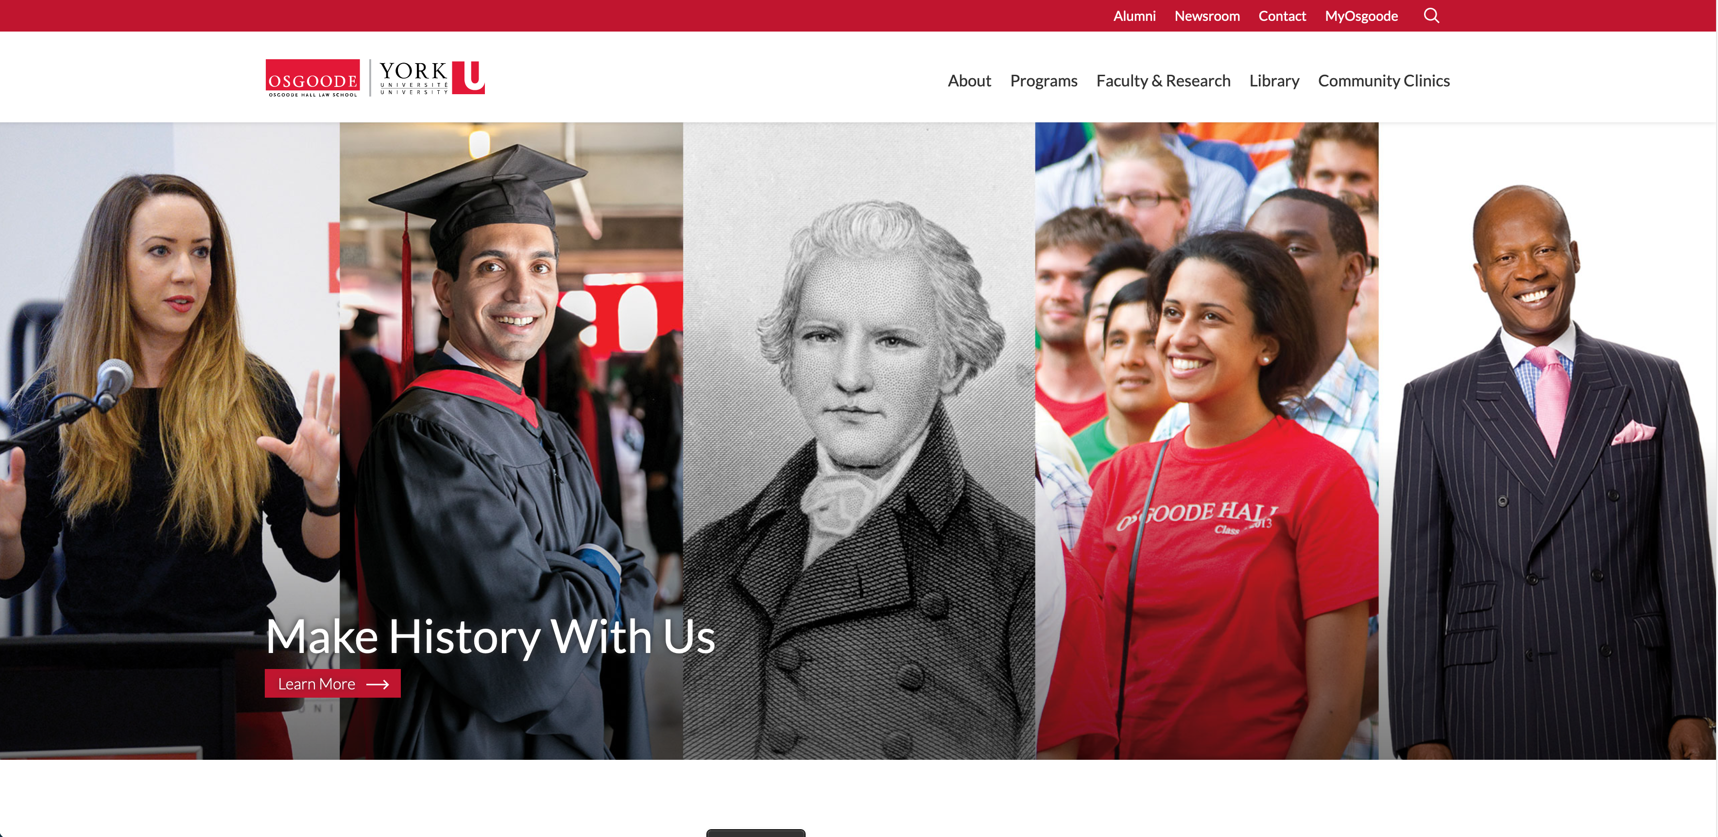

a tale of two educators
Osgoode Hall Law School Toronto, Ontario
Canadian Centre for Professional Legal Education (CPLED) Calgary, Alberta

Slide 21
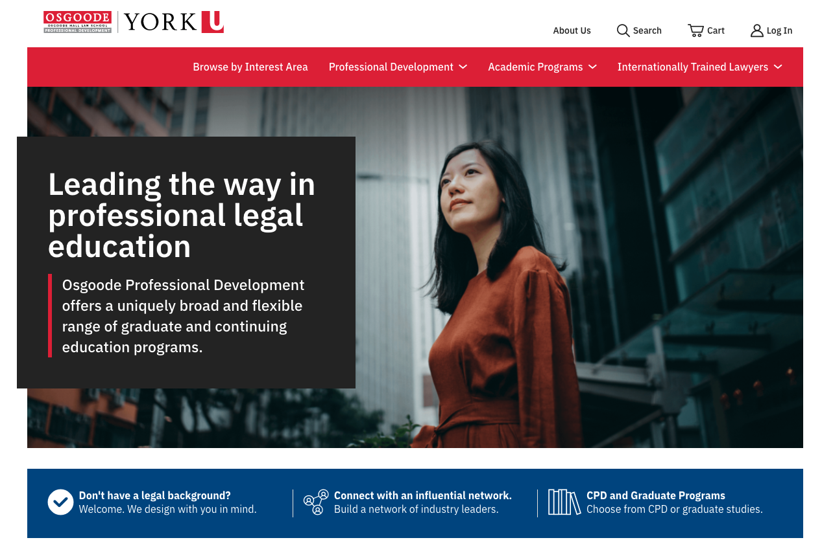
Osgoode
300 first year students in law degree (1Ls) completed summative & formative in-person SC interview in Introduction to Legal Skills 2018/2019 and 2019/2020
1L SC interviews online in 2020-2024
Formative interviews for lawyers in continuing legal education certificates, in Osgoode Professional Development:
Family Law Skills and Practice (40 lawyers)
In person 2019/2020
Online 2020/2021
Advanced Workplace Investigations (32 lawyers)
Online 2020/2021
Further uses planned

Slide 22
Family Law Skills and Practice
Key difference – participants are licensed lawyers, not law students, therefore less concern about knowing the law, but even more desire to improve their practice
9-day intensive skills programme, with 4 points of SC interaction:
Initial client Interview (same assessment criteria, but higher standards of performance expected)
‘Challenging client’ meeting
‘Pre-negotiation’ meeting
Case conference

Slide 23
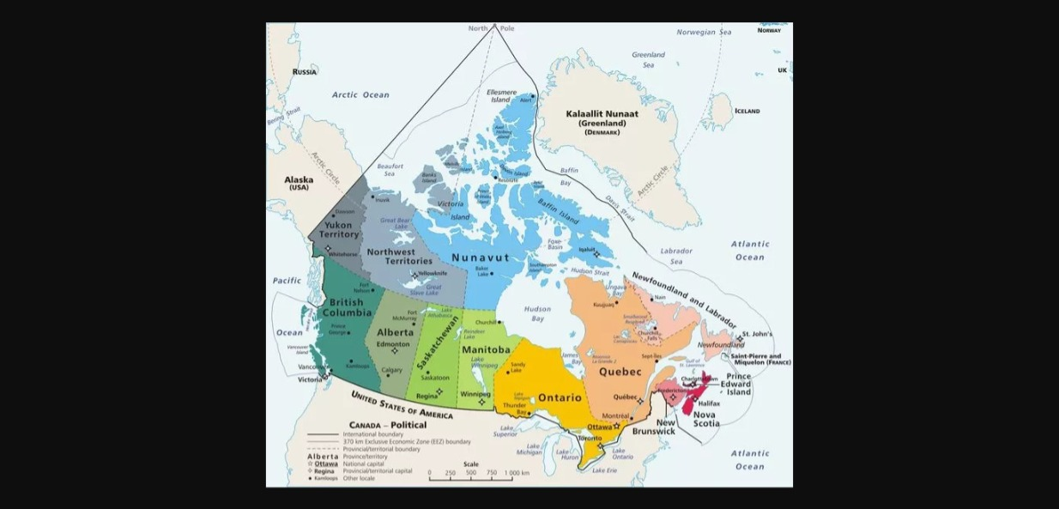
CPLED
Participating provinces: BC, AB, SK, MB, NV, NS.
Area: c.1.9M sq miles (by contrast, EU c.1.7…)
Practising lawyers: c.30,000
Law schools: 8 (by contrast, 9 law schools in Ontario)

Slide 24
CPLED
CPLED hosts the Practice Readiness Education Program (PREP)
Bar admission course - c.800 students, mostly online
Practical lawyering skills, including SC interviews
Each student has formative practice interviews then final summative interview (Capstone)
Practice interviews formative and summative
Capstone is summative only
Four-step design…

Slide 25
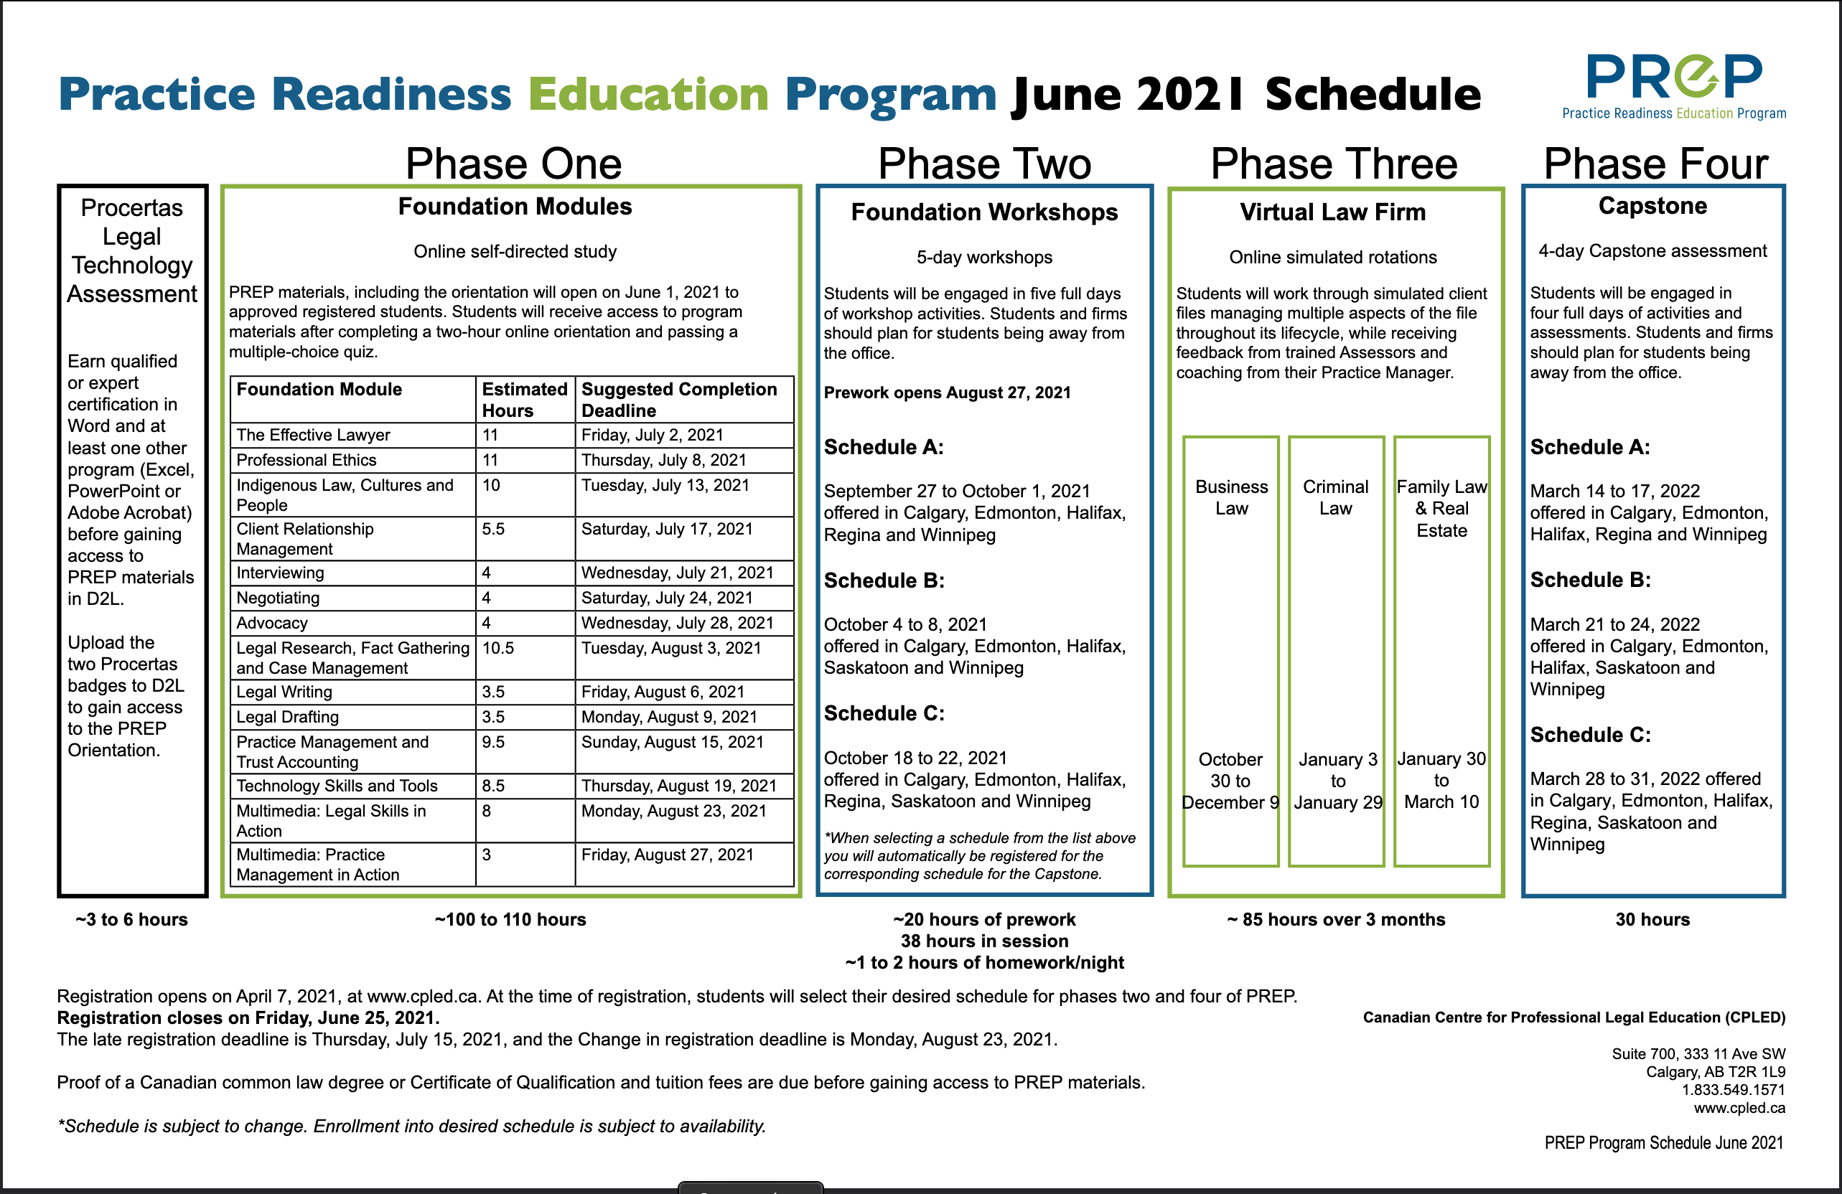
PREP schedule

Slide 26
PREP: the four-step design
3.
Students practise interviewing with SCs - feedback given by SC
2.
Students practise interviewing with each other – feedback given by students & tutors
4.
Students summatively assessed by SCs – no feedback given unless a fail
1.
Online multimedia modules, linked to Foundation workshops

Slide 27
Future projects…

Slide 28
future projects
Use of AI to prepare students for interviews: both skills & knowledge
Use of video annotation software for reflective learning
Further work with regulators on the development of academic/professional education

Slide 29
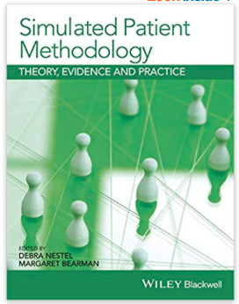
future projects
Small, agile, empirical projects
Online library of digital resources – annotated videos & textual resources.
Publication of a SC book edited by Macleod, Maharg & Yenssen, 2026/27, Emerging Legal Education series, Routledge, drawing on work of the past two decades & based on similar book by Nestel & Bearman on SPs

Slide 30
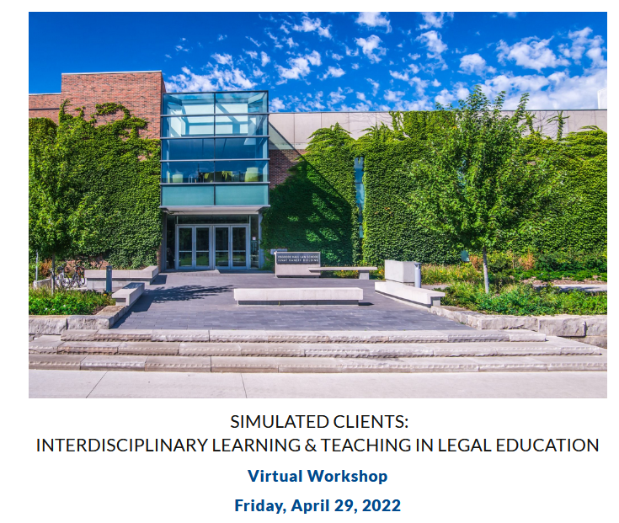
workshops
London, Gray’s Inn, 2016
Canberra, ANU College of Law, 2017
Toronto, Osgoode Hall Law School, 2022
Amsterdam, Amsterdam Law School, 20 July 2024
Manchester, Manchester Law School, 2026?
Elsewhere? Open to suggestions…

Slide 31
Final thoughts…

Slide 32
feasibility? cost? impact?
Feasible…?
Very: lots of experience out there in at least 17 centres. Initial and refresher training needed for SCs, but no high-maintenance.
Cost…?
Training of SC trainer + SCs; payment of SCs.
SC documentation is freely available under Creative Commons
Impact…?
Big: on students, on ethical performance, practice of skills within professional value contexts; formative and high-stakes assessment.
Also on regulatory bodies, eg Law Society of Scotland, SRA, CPLED.

Slide 33
SCs: people as co-producers, co-designers
The SC approach challenges:
Curriculum methods
Ethics of the client encounter
The cognitive poverty of conventional law school assessment
Law school as a self-regarding, monolithic construct
Law school categories of employment
The curricular isolation of clinic within law schools
Hollowed-out skills rhetoric
Conventional forms of regulation by regulatory bodies
The role of regulator, as encourager of innovation & radical reform…?
Disciplinary boundaries – how could a SC Unit become interdisciplinary?
Local vs global in jurisdictional practices: how might such a project work globally?

Slide 34
more information
Barton, K., Cunningham, C.D., Jones, G.T., Maharg, P. (2006). Valuing what clients think: standardized clients and the assessment of communicative competence. Clinical Law Review, 13, 1, 1-65.
Barton, K., Garvey, J.B., Maharg (2013). ‘You are here’: learning law, practice and professionalism in the academy. In Bankowski, Z., Maharg, P. del Mar, M., editors, The Arts and the Legal Academy. Beyond Text in Legal Education, vol 1. Routledge.
Gerkman, A., Harman, E., Bond, L., Sullivan, W.M. (2015). Ahead of the Curve: Turning Law Students into Lawyers. A Study of the Daniel Webster Scholar Honors Program at the University of New Hampshire School of Law. IAALS, University of Denver, http://bit.ly/2PVcNSS .
Maharg, P, Yenssen, A. (2022). Transitioning simulated client interviews from face-to-face to online: Still an entrustable professional activity? European Journal of Law and Technology, 13, 3. Available at: https://ejlt.org/index.php/ejlt/article/view/899.
Workshop. (2022). Simulated clients: Interdisciplinary learning and teaching in legal education. Osgoode Hall Law School. Slides, papers, documents available at https://simclient.osgoode.yorku.ca/ .

Slide 35

d
Email: pmaharg@osgoode.yorku.ca
Web: https://paulmaharg.com

