Slide 1

Simulated clients – situated theory and practices
Professor Paul Maharg
Osgoode Professional Development
Osgoode Hall Law School

Slide 2
preview
The Simulated Client Initiative (SCI) – origins, current projects
Training SCs
The SCI in Canada – some examples
Future projects
Final thoughts

Slide 3
1. Simulated clients (SCs)…?

Slide 4
Why SCs?
In substantive courses, students often learn about legal problem solving in fragmented steps
But students seldom practise these in real time with real people to solve real problems
Above all, it helps them find their voice, professionally and ethically
Interviewing SCs introduces students to lawyer-client relationship dynamics and the fusion of practical information gathering with legal analysis

Slide 5
SCs - origins
Strathclyde University, 2005, pilot project (partners Georgia State University College of Law, Dundee University Medical Faculty)
Used model from medical profession of Simulated Patients (SPs), non-lawyers were trained to be Simulated Clients (SCs)
Our study proved SCs assessed important aspects of client interviewing with better validity and reliability than teachers
Made what client thinks important the most salient for the student: the interview grade is given by the client
SCs evaluate those aspects of the interview that can be assessed by non-lawyers
This has changed how we enable students, trainees and lawyers to learn interviewing & client-facing ethical behaviour
Paul Maharg | CC BY-NC-ND 2.5 CANADA

Slide 6
current status of SCI projects
University of Strathclyde Law School (Glasgow, Scotland) | WS (Writers to the Signet Society) (Edinburgh, Scotland)
University of New Hampshire Law School (Concord, NH, USA) | The Australian National University College of Law (Canberra, ACT, AUS)
Northumbria University Law School (Newcastle, England) | Kwansei Gakuin University Law School (Osaka, Japan)
Hong Kong University Faculty of Law (Hong Kong) | The Chinese University of Hong Kong (Hong Kong)
Nottingham Trent University Law School (Nottingham, England) | Newcastle University Law School (Newcastle, England)
Osgoode Hall Law School/ OPD (Toronto, ON, CA) | University of Windsor Faculty of Law (Windsor, ON, CA)
Flinders Law School (Adelaide, SA, AUS | Solicitors Regulation Authority (London, England)
Canadian Centre for Professional Legal Education (CPLED, Provinces of AB, MB, SK, NS, CA) | Law Society of Ireland (Dublin, Ireland)
National Centre for Skills in Social Care (London, England)

Slide 7

independent studies…
In focus groups, members of the profession and alumni said they believe that students who graduate from the program are a step ahead of new law school graduates;
When evaluated based on simulated client interviews, students in the program outperformed lawyers who had been admitted to practice within the last two years;
The only significant predictor of simulated client interview performance was whether or not the interviewer participated in the Daniel Webster Scholar Honors Program. Neither LSAT scores nor class rank was significantly predictive of interview performance.
Gerkman, A., Harman, E., Bond, L., Sullivan, .M. (2015). Ahead of the Curve: Turning Law Students into Lawyers. A Study of the Daniel Webster Honors Program. IAALS, Denver.

Slide 8
2. SC training

Slide 9
Four-day programme: SC training day 1 - script conference
introduction to the method; discussion of roles
read scenario script as a group
discuss roles, bias and unconscious bias
discuss SCs’ feelings, reactions; amend the script
clear up ambiguities re role of lawyer
facilitator uses SC feedback to modify the scenario

Slide 10
SC training day 2: practising the role
There’s a need for the SCs to calibrate:
Body language
Tone of voice
Attitudinal swings
Dealing with the lawyer’s open questions…
Improvising on the lawyer’s closed questions…
Performance analysis on video review: ‘What prompted you to say…?’ ‘How did you feel…?’
And to:
Be aware of their orientation towards lawyer at first sight
Respond congruently to the lawyer
Consult their internal ‘invigilator’…

Slide 11
SC training days 3 & 4: assessing lawyers/law students
We discuss the marking system, and form a common understanding of it
SCs view and mark videos, comparing to ‘standard’
SCs view each other’s ‘live’ performances with lawyers & actors and assess lawyers & actors
Process repeated until everyone has role-played at least once, ideally three times or more
Rich, detailed comment on performance
Marks are collated in the room & discussed
SCs are also trained to give formative feedback

Slide 12
Matching standards to criteria - eg assessment criterion 2
2. I felt the student lawyer listened to me.
This item is designed to assess the degree to which the lawyer can listen carefully to you. These criteria focus especially on the early part of the meeting when the client should be encouraged to tell their story and concerns in their own words. This entails active listening – where it is necessary for the interview structure or the lawyer’s understanding of your narrative. The lawyer will not interrupt, cut you off, talk over you or rush you in conversation. The lawyer reacts to your responses appropriately. The lawyer may take notes where appropriate, but if the lawyer does so, the lawyer should not lose much eye contact with you. To some extent in this item we are concerned with what the lawyer does not do that facilitates the interview.

Slide 13
I felt the student lawyer listened to me
1 | 2 | 3 | 4 | 5
Lawyer prevents you from talking by interrupting, cutting off, talking over, rushing you. Takes over the conversation prematurely as if the lawyer already knows all the answers. | Lawyer limits your opportunity to talk by interrupting, cutting you off, etc. You are allowed to answer specific questions but are not allowed to expand on topics. | Lawyer rarely interrupts or cuts off or rushes you. The lawyer reacts to your responses appropriately in order to allow you to tell your story. More interested in notes taken than in eye-contact with you. | The lawyer is clearly listening closely to you. If the lawyer interrupts, it is only to assist you in telling the story more effectively. Lawyer provides opportunities for you to lead the discussion where appropriate. Good eye contact and non-verbal clues. | The lawyer is an excellent listener and speaks only when it is clearly helpful to your telling your story. Lawyer uses silence and other non-verbal facilitators to give you an opportunity to expand. Excellent eye contact and non-verbal cues.

Slide 14
1 | 2 | 3 | 4 | 5
Lawyer prevents you from talking by interrupting, cutting off, talking over, rushing you. Takes over the conversation prematurely as if the lawyer already knows all the answers. | Lawyer limits your opportunity to talk by interrupting, cutting you off, etc. You are allowed to answer specific questions but are not allowed to expand on topics. | Lawyer rarely interrupts or cuts off or rushes you. The lawyer reacts to your responses appropriately in order to allow you to tell your story. More interested in notes taken than in eye-contact with you. | The lawyer is clearly listening closely to you. If the lawyer interrupts, it is only to assist you in telling the story more effectively. Lawyer provides opportunities for you to lead the discussion where appropriate. Good eye contact and non-verbal clues. | The lawyer is an excellent listener and speaks only when it is clearly helpful to your telling your story. Lawyer uses silence and other non-verbal facilitators to give you an opportunity to expand. Excellent eye contact and non-verbal cues.

Slide 15
1 | 2 | 3 | 4 | 5
Lawyer prevents you from talking by interrupting, cutting off, talking over, rushing you. Takes over the conversation prematurely as if the lawyer already knows all the answers. | Lawyer limits your opportunity to talk by interrupting, cutting you off, etc. You are allowed to answer specific questions but are not allowed to expand on topics. | Lawyer rarely interrupts or cuts off or rushes you. The lawyer reacts to your responses appropriately in order to allow you to tell your story. More interested in notes taken than in eye-contact with you. | The lawyer is clearly listening closely to you. If the lawyer interrupts, it is only to assist you in telling the story more effectively. Lawyer provides opportunities for you to lead the discussion where appropriate. Good eye contact and non-verbal clues. | The lawyer is an excellent listener and speaks only when it is clearly helpful to your telling your story. Lawyer uses silence and other non-verbal facilitators to give you an opportunity to expand. Excellent eye contact and non-verbal cues.

Slide 16
after initial training?
SCs role-play clients with students, real lawyers and other professionals
SCs are given refresher training on the scenario
If they are trained on a new scenario they will have the same pattern of training
They should form a community of practice with two core members of staff – ideally admin + academic to:
improve practice
suggest ways they may be used inside or outside the law school
Community to be as social and democratic as possible

Slide 17
training SCs online
Three components of review script, performance feedback, & benchmark grading are adapted with different tools:
Breakout rooms
Demonstration videos
Screen sharing
Chat function
Quite different performativities need to be explored and practised, eg
Image, gesture, audio
Camera angles
Conversational turn-taking

Slide 18
learner interviews online
Again, same principles – but context always affects communications…
Some of the issues that arose online:
Social representation, warmth, intimacy, formality, pose, repose, affective presence on video?
Bandwidth: is there still a digital divide?
Recording: how does it enhance / constrain learning?
Assessment: digital affects formative feedback. And summative…?

Slide 19
3. The SCI in Canada – some examples

Slide 20
current status of SCI projects
University of Strathclyde Law School (Glasgow, Scotland) | WS (Writers to the Signet Society) (Edinburgh, Scotland)
University of New Hampshire Law School (Concord, NH, USA) | The Australian National University College of Law (Canberra, ACT, AUS)
Northumbria University Law School (Newcastle, England) | Kwansei Gakuin University Law School (Osaka, Japan)
Hong Kong University Faculty of Law (Hong Kong) | The Chinese University of Hong Kong (Hong Kong)
Nottingham Trent University Law School (Nottingham, England) | Newcastle University Law School (Newcastle, England)
Osgoode Hall Law School/ OPD (Toronto, ON, CA) | University of Windsor Faculty of Law (Windsor, ON, CA)
Flinders Law School (Adelaide, SA, AUS | Solicitors Regulation Authority (London, England)
Canadian Centre for Professional Legal Education (CPLED, Provinces of AB, MB, SK, NS, CA) | Law Society of Ireland (Dublin, Ireland)
National Centre for Skills in Social Care (London, England)

Slide 21
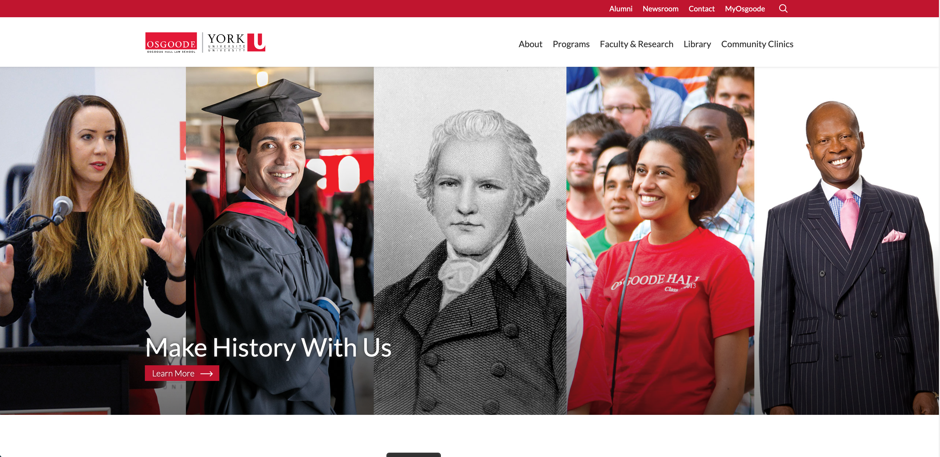

a tale of two educators
Osgoode Hall Law School Toronto, Ontario
Canadian Centre for Professional Legal Education (CPLED) Calgary, Alberta

Slide 22
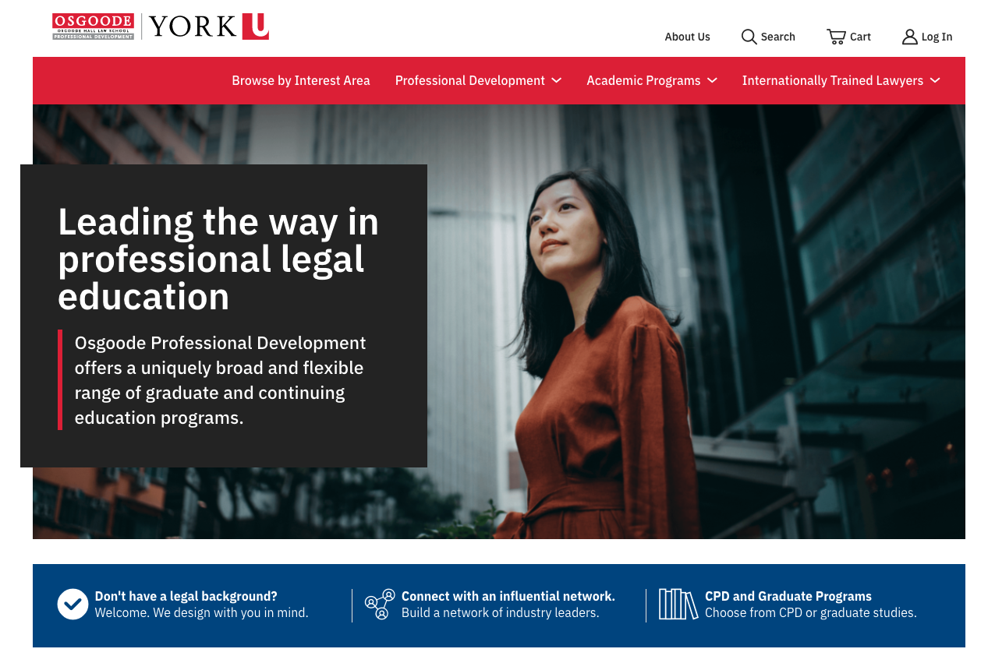
Osgoode
300 first year students in law degree (1Ls) completed formative in-person SC interview in Legal Process subject, 2018/2019 and 2019/2020
1L SC interviews online in 2020-2024
Formative interviews for lawyers in continuing legal education certificates, in Osgoode Professional Development:
Family Law Skills and Practice (40 lawyers)
In person 2019/2020
Online 2020/2021
Advanced Workplace Investigations (32 lawyers)
Online 2020/2021
Further uses planned

Slide 23
Family Law Skills and Practice
Key difference – participants are licensed lawyers, not law students, therefore less concern about knowing the law, but even more desire to improve their practice
9-day intensive skills programme, with 4 points of SC interaction:
Initial client Interview (same assessment criteria, but higher standards of performance expected)
‘Challenging client’ meeting
‘Pre-negotiation’ meeting
Case conference – meeting (before and) with a judge

Slide 24
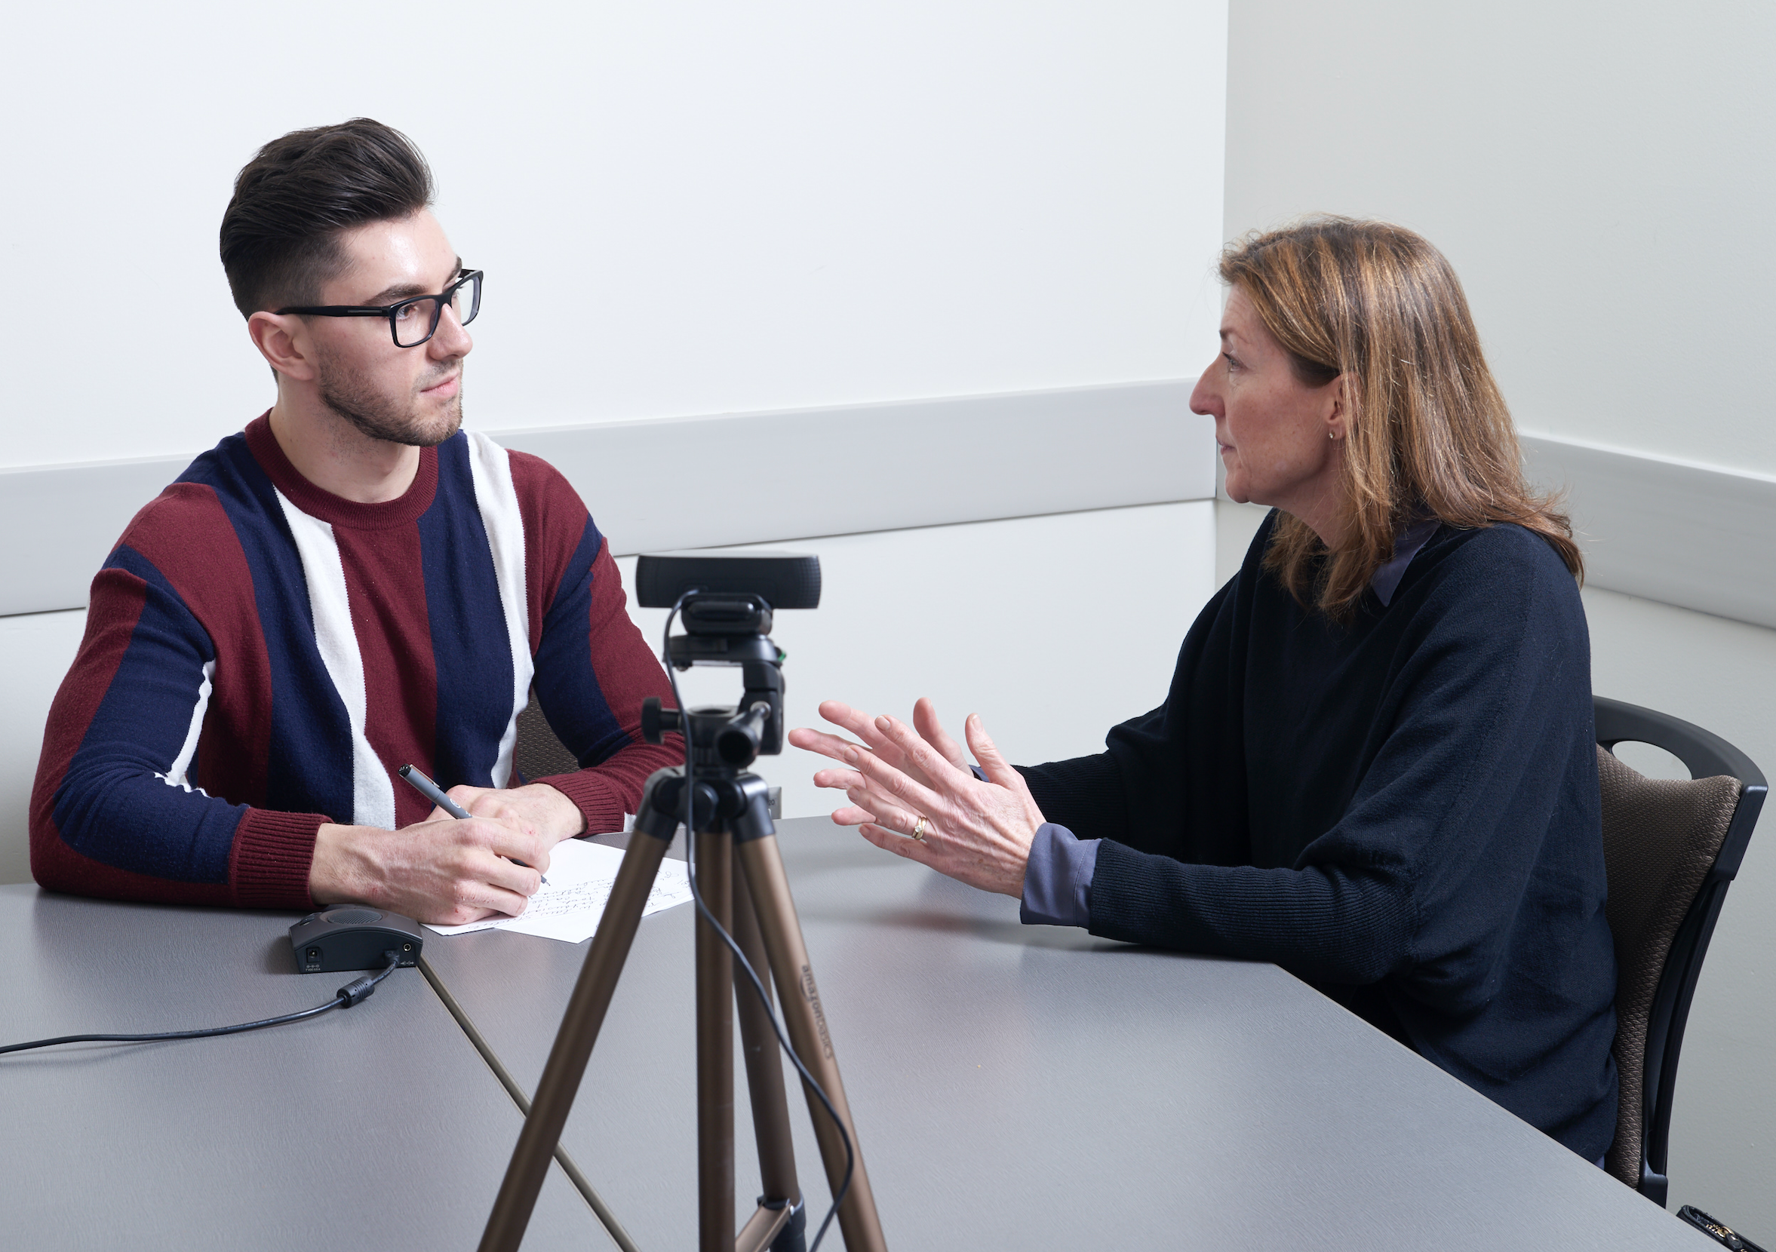
at Osgoode: was this experiential learning authentic? useful?
15 SCs were recruited, trained and used with 290 students 2018, 306 students 2019, in a 1L course, Legal Method and all years since then.
Excellent feedback. In 2018:
92.6% thought the interview experience authentic or very authentic.
95.5% thought the clients realistic or very realistic in conveying their concerns.
93.5% thought the experience useful or very useful in preparing them for real client interviews.
97.6% thought that the use of simulated clients was more beneficial to their learning than practising only with other students
Notes:
We’ve already used SCs on a pilot project in the Osgoode JD, and the results were outstanding. Here are some of the stats we collected in interim feedback.

Slide 25
some comments…
‘One of my favourite and most worthwhile opportunities all year’
‘Great opportunity! […] Good low stress experience’
‘I loved the feedback that the simulated client gave me. She was honest (but also very kind). I haven’t viewed my video yet , but I’m sure it will be extremely useful to go back and review my questions/demeanour/etc.’
‘I would love to get more opportunities to do this’
‘Yes, I feel better prepared and the feedback I got was very reassuring’
‘I really enjoyed this experience and would recommend that it be implemented into the legal process course curriculum’
‘The feedback was splendid I see where I need to improve and at the same time I was made aware of my strengths that I need to hone’
‘I feel like it was worthwhile and that we should have more opportunities to participate in similar activities’
Notes:
And here are some comments students made about the interviews they had with the SCs. Again, very positive.
What this shows is how powerful the method is, how much students are engaged by the process, and how much they learn in a short space of time.

Slide 26
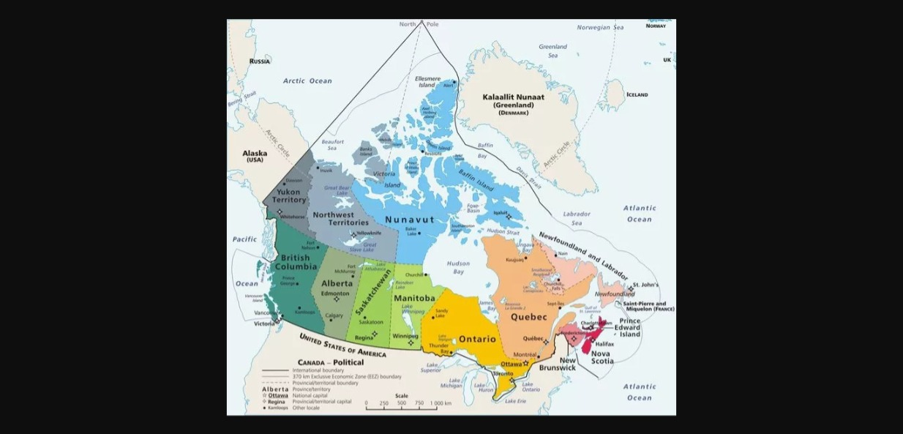

Slide 27
CPLED
Practice Readiness Education Program (PREP)
Bar admission course Alberta, Saskatchewan, Manitoba, Nova Scotia - c.800 students, mostly online
Practical lawyering skills, including SC interviews
Each student has 2 practice interviews then final summative interview (Capstone)
Practice interviews formative and summative
Capstone summative only

Slide 28
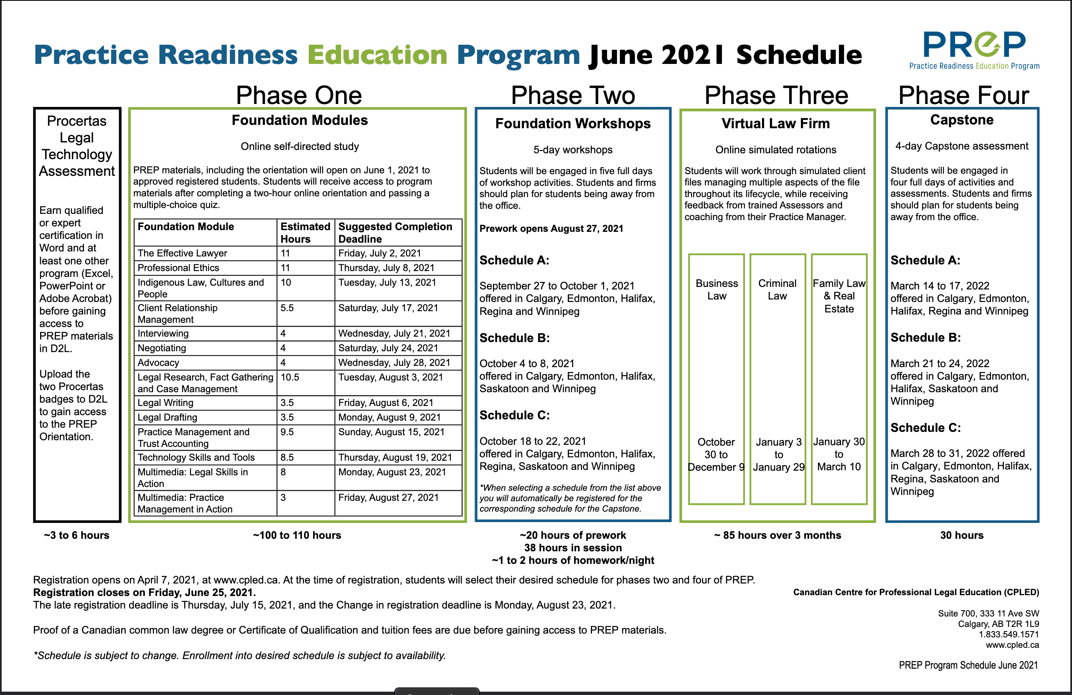
PREP schedule

Slide 29
4. Future projects

Slide 30
future projects
Use of AI to prepare students for interviews: both skills & knowledge
Use of video annotation software for reflective learning
Dovetailing of digital sim platform, SIMPLE (already in preparation for OPD, 2024/25, budget $650,000 CAD) with SC performance
Further work with regulators on the development of academic/professional education

Slide 31
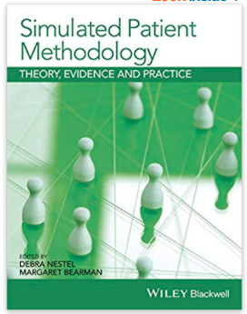
future projects
Small, agile, empirical projects
Online library of digital resources – annotated videos & textual resources.
Publication of a SC book edited by Maharg & Yenssen, 2025/26, Emerging Legal Education series,Routledge, drawing on work of the past two decades & based on similar bookby Nestel & Bearman on SPs

Slide 32
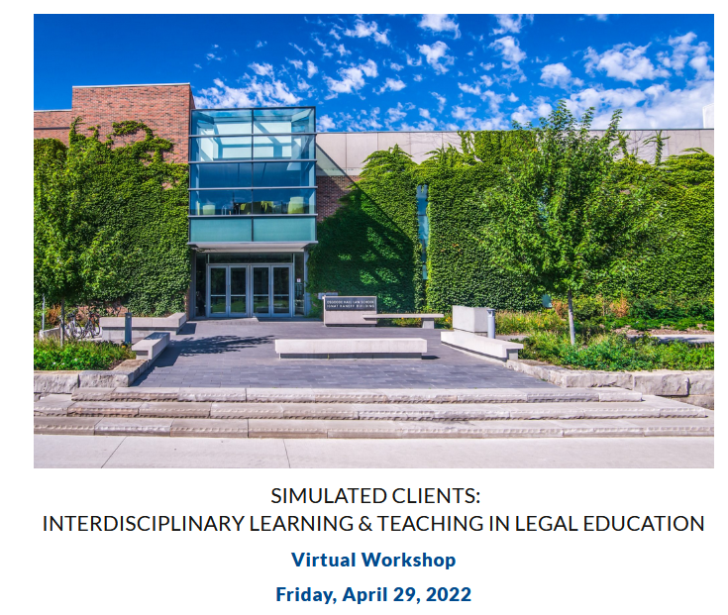
future workshops
London, Gray’s Inn, 2016
Canberra, ANU College of Law, 2017
Toronto, Osgoode Hall Law School, 2022
Amsterdam, Amsterdam Law School, 20 July 2024
Manchester, Manchester Law School, 2026
Elsewhere…?

Slide 33
5. Final thoughts

Slide 34
feasibility? cost? impact?
Feasible…?
Very: lots of experience out there in at least 17 centres. Initial and refresher training needed for SCs, but no high-maintenance.
Cost…?
Training of SC trainer + SCs; payment of SCs.
SC documentation is freely available under Creative Commons
Impact…?
Big: on students, on ethical performance, practice of skills within professional value contexts; formative and high-stakes assessment.
Also on regulatory bodies, eg Law Society of Scotland, SRA, CPLED.

Slide 35
SCs: people as co-producers, co-designers
The SC approach challenges:
Curriculum methods
Ethics of the client encounter
The cognitive poverty of conventional law school assessment
Law school as a self-regarding, monolithic construct
Law school categories of employment
The curricular isolation of clinic within law schools
Hollowed-out skills rhetoric
Conventional forms of regulation by regulatory bodies
The role of regulator, as encourager of innovation & radical reform…?
Disciplinary boundaries – how could a SC Unit become interdisciplinary?
Local vs global in jurisdictional practices: how might such a project work globally?

Slide 36
context of the demo interview
Lawyer has been informed that: Jane Smith is coming in seeking assistance with a family law matter she is having with her spouse.
Personal contact details have been taken already
Interview is shorter than usual (for purposes of demonstration)
This is a formative interview: no grades will be given, and the SC will give feedback to the lawyer at the end of the interview on the eight assessment criteria.
Watch, listen, with the eight criteria in mind
Lawyer & client will take part with you in discussion after the interview and feedback has ended

Slide 37
more information
Barton, K., Cunningham, C.D., Jones, G.T., Maharg, P. (2006). Valuing what clients think: standardized clients and the assessment of communicative competence. Clinical Law Review, 13, 1, 1-65.
Maharg, P. (2007). Transforming Legal Education: Learning and Teaching the Law in the Early Twenty-first Century. Aldershot, Ashgate Publishing, chapter 2, 64-67.
Garvey, J.B. (2010). New Hampshire’s performance-based variant of the Bar Examination, http://www.ncbex.org/uploads/user_docrepos/790210_Garvey.pdf
Barton, K., Garvey, J.B., Maharg (2013). ‘You are here’: learning law, practice and professionalism in the academy. In Bankowski, Z., Maharg, P. del Mar, M., editors, The Arts and the Legal Academy. Beyond Text in Legal Education, vol 1. Routledge.
Gerkman, A., Harman, E., Bond, L., Sullivan, W.M. (2015). Ahead of the Curve: Turning Law Students into Lawyers. A Study of the Daniel Webster Scholar Honors Program at the University of New Hampshire School of Law. IAALS, University of Denver, http://bit.ly/2PVcNSS .
Maharg, P, Yenssen, A. (2022). Transitioning simulated client interviews from face-to-face to online: Still an entrustable professional activity? European Journal of Law and Technology, 13, 3. Available at: https://ejlt.org/index.php/ejlt/article/view/899.

Slide 38

d
Email: pmaharg@osgoode.yorku.ca
Web: https://paulmaharg.com

