Slide 1


Slide 2
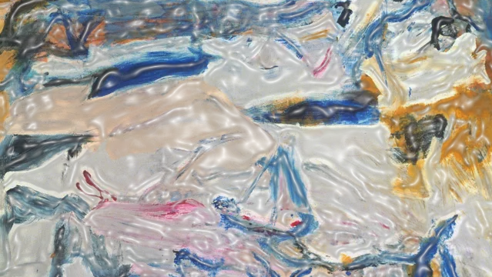
Mapping Lines of Flight:
Toward a Rhizomatic Methodology for Comparative Legal Education
Kryss Macleod
Paul Maharg

Slide 3
Outline
Context & motivation
Comparative framework for small jurisdictions
Methodology: Deleuze & Guattari’s cartography
Future research directions & implications
Notes:
Brief the audience on what to expect. Emphasise the 25‑minute structure: ~3 min per main section, 2 min discussion.

Slide 4
Why Study Small Jurisdictions?
Under‑represented in legal education discourse
Dominance of large, wealthy jurisdictions skews comparisons
Limited understanding of sociocultural contexts
How can a focus on small jurisdictions enrich theory & practice in legal education?
Notes:
Highlight the projects’s central theme: small jurisdictions = inclusive theorisation. Frame the research question clearly.

Slide 5
Literature Gaps
Most research = single‑case or 2‑3 jurisdiction comparisons
Example: Ireland’s ‘internationalising’ pathway (Gopalan & Paris, 2016)
Need for broader, multi‑site studies focusing on smallness itself
Notes:
Point out that methodological tooling lags behind the questions we now need to ask.

Slide 6

Why rethink comparative legal education?
Large jurisdictions dominate discourse
‘Metropolitan blindness’ (Crossley & Tikly 2004)
Small systems are agile laboratories
Notes:
Use quick stats or anecdote: 85 % of legal‑ed articles sample 6 OECD states; contrast with 40+ micro‑jurisdictions.

Slide 7
Defining “Small” is Hard
World Bank: <1.5 m pop. (but exceptions)
Maass (2017): conceptual flexibility over rigid definition
This study: focus on jurisdictionality, not sovereignty
Embrace ‘hazy edges’ to allow exploratory analysis
Notes:
Stress that fuzzy boundaries facilitate richer comparative insights instead of forced categorisation.

Slide 8
Two Immediate Explanations for Neglect
Scarcity of local scholars & resources
Regulatory literature of large jurisdictions crowds discourse
Notes:
Expand: Fewer academics = fewer publications; dominant jurisdictions’ policy documents become default references.

Slide 9
Jurisdictional Complexity Examples
Faroe Islands: autonomous yet non‑sovereign
Scotland: devolved nation with distinct legal tradition
Others: Malta, Jersey, Seychelles as crossroads
Shadow effects of neighbouring ‘giants’ (eg., Denmark, England)
Notes:
Prompt reflection: where do audience members’ jurisdictions sit on this spectrum?

Slide 10
Beyond Simplicity: Complexities of Size
Fault‑lines, fractures, transplants, erasures
‘Legal irritants’ (Teubner, 1998) in small systems
Need to surface hidden curricular & cultural dynamics
Notes:
Use examples: eg., imposed curricula in colonial contexts or rapid adoption of foreign qualifications, to illustrate complexity.

Slide 11
Critiquing Static Models
Bray & Thomas (1995) Cube: levels, aspects, non‑locational factors, but overlooks regulation layers (eg. SRA)
Digital revolution reshapes comparative space
Need dynamic, relational mapping of actors & forces
Notes:
Segue into Deleuze & Guattari: we need maps that MOVE.

Slide 12

Empirical Project: 8 North Atlantic Jurisdictions
Nova Scotia
Greenland
Iceland
Faroe Islands
Scotland
Northern Ireland
Ireland
Wales
Key aims: map histories, forecast futures, enrich theory
Notes:
Encourage attendees to imagine comparative cases.

Slide 13
Methodological Challenges
Sartori’s ‘conceptual stretching’ trap
Assumption of internal homogeneity questioned (Salaymeh & Michaels, 2022)
Need emergent, context‑sensitive comparison terms
Notes:
Reassure audience: embracing complexity is methodological strength, not weakness.

Slide 14
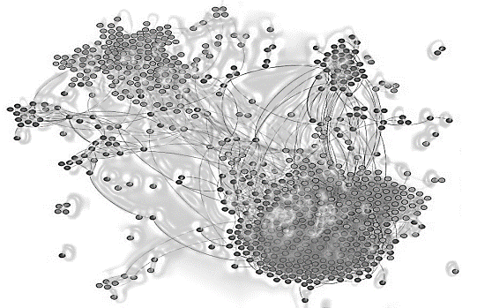
THEORETICAL FOUNDATIONS - Cartography & Rhizomes (Deleuze & Guattari, 1988)
Assemblage: interconnected, multi‑scalar actors
Rhizome: connects any point to any other, grows from the middle
Lines of flight: pathways to new thought & practice
Notes:
Walk through steps: 1) map assemblage, 2) trace lines of flight, 3) compare emergent patterns
Rhizomatic cartography mapping actors & relations
Focus on heterogeneity & lateral connections
Avoid ‘methodological nationalism’ (Dale, 2005)
Surface deterritorialisation & innovation zones

Slide 15
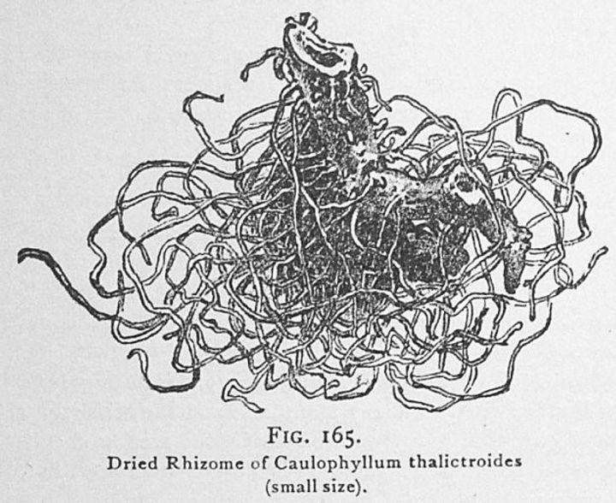
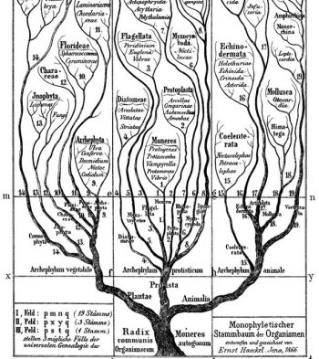
Notes:
Rhizome: ‘subconscious’, ‘subterranean’, ‘subversive’, ‘a non-linear, multi-directional underground web of connections’.links are ‘haphazard’, ‘messy’, ‘serendipitous’, ‘esoteric’, ‘dynamic’, ‘unbounded’, ‘unpredictable’, ‘adaptive’, ‘self-organising’ and ‘non-hierarchical’.
Use simple analogy: compare rhizome to internet hyperlink network vs. tree folder system.
A. rhizomes versus trees
Deleuze and Guattari contrast rhizomes—de‑centred, non‑hierarchical networks—with arborescent structures that impose linear order (Deleuze & Guattari 1988). CF tree of knowledge – The rhizome, on the other hand “ceaselessly establishes connections between semiotic chains, organizations of power, and circumstances relative to the arts, sciences, and social struggles” (Deleuze and Guattari, 2004/1988 p. 7).
In educational research, rhizomatic models describe open, learner‑driven curricula where "the community is the curriculum" (Cormier 2008). Applying this to comparative legal education foregrounds contingent linkages among curricula, regulations, technologies and cultural norms, resisting binary taxonomies such as ‘civil‑’ versus ‘common‑law’ that often obscure hybridity in small systems (Donlan et al 2017).

Slide 16
Three key questions:
(i) How can assemblage theory re‑orient comparative legal‑education methodology away from size‑centric hierarchies?
(ii) Which conceptual tools illuminate the distinctive dynamics of small jurisdictions while remaining portable across contexts?
(iii) What lines of flight help reconfigure the assemblage, opening new pathways for the development of legal education?

Slide 17
TOWARD A RHIZOMATIC METHODOLOGY
A. Mapping actors and artefacts
B. Tracing forces and flows
C. Identifying lines of flight
D. Comparative synthesis
Notes:
A. Mapping actors and artefacts
The first step is to map universities, regulators, professional societies, accreditation bodies, digital infrastructures and cultural norms that compose a legal‑education assemblage. This inventory is open‑ended; new elements surface as research unfolds (Semetsky 2004). Ethnographic and documentary methods provide the granularity required to capture tacit practices and hidden curricula (Giroux & Penna 1979).
B. Tracing forces and flows
We will then track material and discursive flows eg professionalisation, technologies, funding streams, policy transfers, online resources, that connect elements across scales. Can see already from workshops the **curricular gravitational pull** captures how dominant jurisdictions attract imitative reforms, shaping everything from assessment formats to pedagogy.. Eg Falcounbridge - "Tailored education programs designed to shape the identities and practices of new recruits" developed by global law firms operating in London have been "globalized and reproduced in different international jurisdictions“ Wales/ Scotland/ Ireland
(Social‑network analysis or bibliometrics might further visualise these gravitational centres?)
C. Ientifying lines of flight
Lines of flight are moments where actors deterritorialise inherited orthodoxies.
Examples might include the integration of Indigenous legal traditions into NS’s foundational courses or the bespoke nature of the Faroes’ legal programme becoming reality and reflecting deeply a form of legal education that supports and represents the work and interests of the communities it serves, Iceland’s agility in response to 2008 financial crisis. Such moves reconfigure the assemblage, opening new pathways for legal knowledge, identity and ethics.
Eg Systematic revival of Welsh as a language of legal instruction, practice and legislation, including: 1) full LLBs taught in Welsh at Cardiff and Bangor; 2) bilingual tutorials for every core module; 3) Senedd-led project to publish fully bilingual statutes and require courts to read both language versions in pari materia.
By re-embedding the Welsh language at every node, curriculum design, statutory drafting, courtroom practice, Welsh actors deterritorialise the centuries-old Anglocentric common-law assemblage. The initiative does not merely add translation layers; it compels scholars and practitioners to operate in a genuinely rhizomatic space where meaning is negotiated between parallel texts and cultural frames. That creative rupture exemplifies a line of flight: it opens pathways for plural epistemologies and challenges the mono-lingual, metropolitan norm that once defined legal education in the jurisdiction.
D. Comparative synthesis
Rather than ranking jurisdictions, the methodology facilitates lateral comparison of assemblage configurations. We will juxtapose **agility thresholds** - the speed and flexibility of regulatory change, and map homologous or divergent patterns without presuming a linear development trajectory (Crossley 2014). Mixed‑methods matrices can visualise convergences, divergences and unexplored zones of potential collaboration.

Slide 18
Identify power ‘takeovers’ that freeze innovation
Multiplicity of regulators, universities, profession & culture
Determinants, magnitudes, dimensions
Notes:
Give concrete example: regulator‑imposed national exam narrowing curricular diversity
Assemblage thinking
Assemblage theory views social phenomena as emergent from heterogeneous elements that cohere temporarily (DeLanda 2006). This ontology aligns with socio‑legal scholarship attentive to the co‑constitution of legal texts, institutions and practices (Creutzfeldt et al 2016). Treating legal education as an assemblage enables researchers to analyse how professional bodies, digital platforms or indigenous knowledge traditions interact to produce distinctive educational ecologies.

Slide 19

Lines of Flight & Inclusive Theorisation
Small jurisdictions as laboratories of agility
Opportunities for co‑created curricula & shared resources
Building a trans‑jurisdictional community of practice
Notes:
Invite audience to reflect: what ‘line of flight’ can they take home?

Slide 20
POTENTIAL APPLICATIONS AND IMPLICATIONS
Doctrinal analysis
Socio‑legal inquiry
Policy and pedagogy
Notes:
5. POTENTIAL APPLICATIONS AND IMPLICATIONS
A. Dcctrinal analysis
Rhizomatic cartography can trace how doctrinal content travels through translation, transplantation or irritation (Watson 1993; Teubner 1998). For instance, corporate‑governance norms migrate to offshore centres, where they hybridise with local trust law and create curricula that challenge doctrinal purity.
B. Cocio‑legal inquiry
Socio‑legal scholars may deploy the framework to examine how power relations shape professional identity, access to justice and curricular reform in under‑researched settings (Salaymeh & Michaels 2022). Mapping assemblages reveals who is authorised to define ‘professional competence’ and whose epistemologies remain marginalised.
C. Policy and pedagogy
Policymakers could use rhizomatic mapping to design collaborative accreditation schemes that pool resources among small jurisdictions, while educators can leverage the framework to scaffold trans‑systemic learning experiences (Kasirer 2003). Digital platforms make it feasible to co‑teach modules across time zones, enacting the rhizome’s principle that any point can connect to any other.

Slide 21
Contribution to scholarship
Re‑centring small jurisdictions within comparative debates, challenging scale‑biased hierarchies;
Operationalising rhizomatic mapping as a portable methodology that integrates doctrinal, conceptual and socio‑legal perspectives; and
Demonstrating how size‑sensitive, assemblage‑based comparison can inform broader discussions on decolonisation, digitalisation and professional ethics in legal education.

Slide 22

Conclusion & Discussion
Small ≠ insignificant: vital for richer comparative insight
Rhizomatic mapping unlocks dynamic understanding
Next steps: empirical validation
Notes:
End with open questions. Allocate final 5 minutes for Q&A.

Slide 23
Scotland: an example of a small jurisdiction:
Introduction
Professional legal education
Research literature on legal education in Scotland: interdisciplinary historical understanding
University differences within the UK settlement: QAA vs enhancement

Slide 24
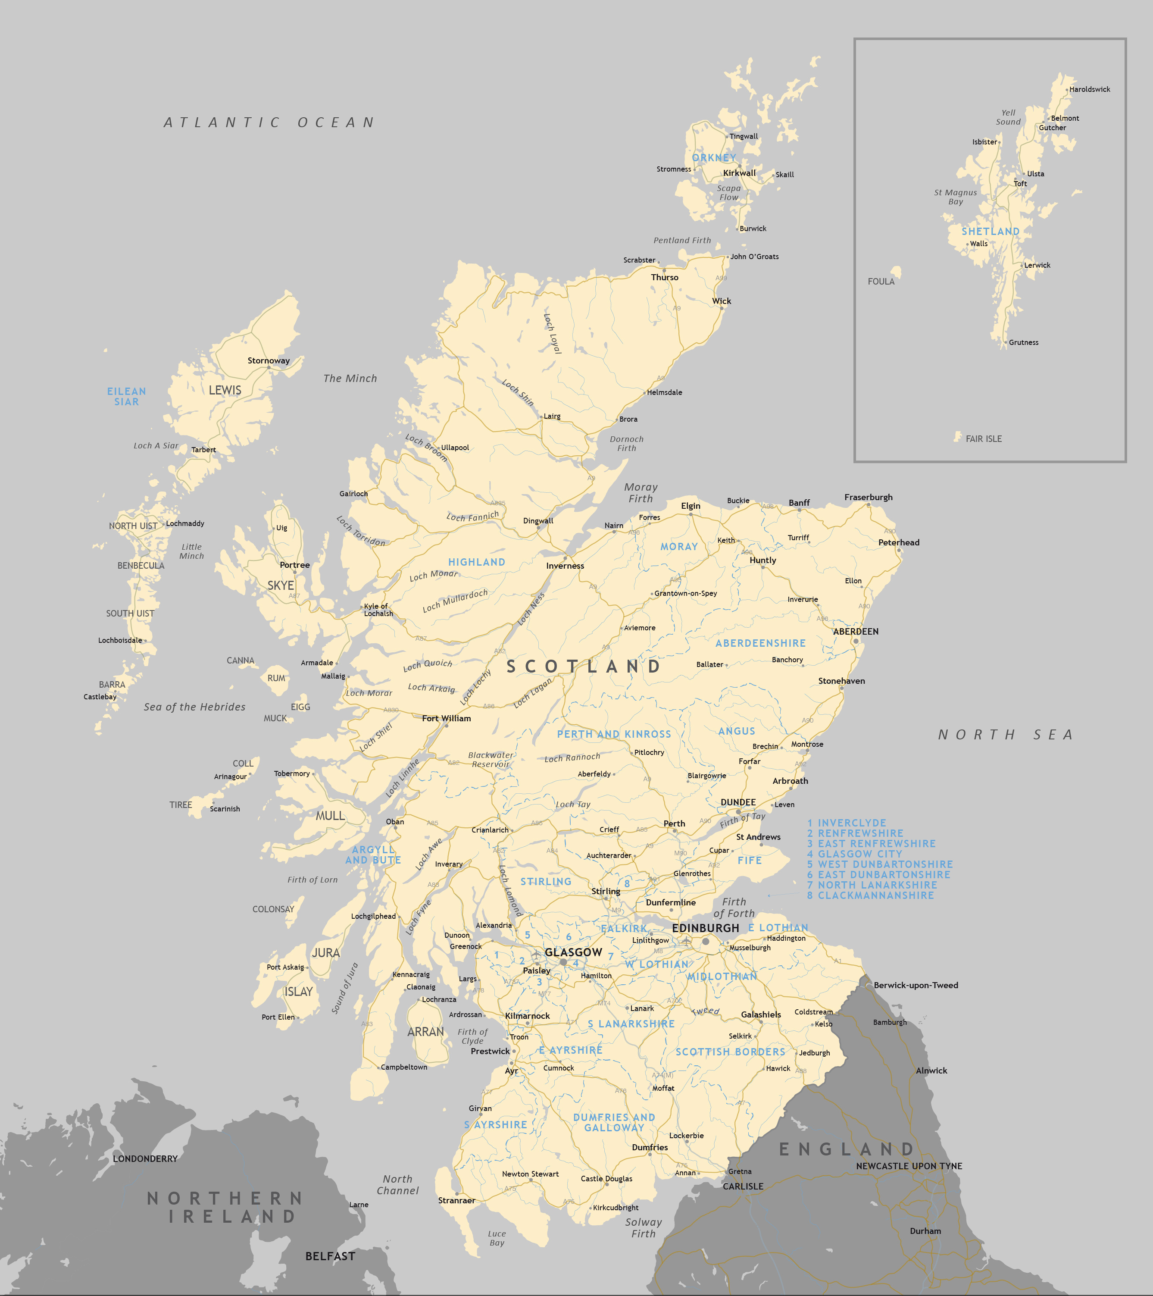
Population: 5.77M (London 9.84M)
Pop density 70/km2, much more scattered in north & west, concentrated in the ‘central belt’ and east coast cities
c.11,000 solicitors (regulator Law Society of Scotland)
c. 500 advocates (Faculty of Advocates)

Slide 25
Scotland is a mixed jurisdiction
The mix…
Scottish common law
Udal law
Feudal law
Canon law
Celtic law
EU law
ECHR law
Civilian law
English common law

Slide 26
Sources & methods of education are mixed
Eg
civilian – glossed mss, commentaries, decretal literature, introduction of printed texts
Continental university education (Catholic & Reformed), giving way in 18th century to education at Scottish institutions – St Andrews, Glasgow, Aberdeen, Edinburgh.
English common law increasingly influential after Parliamentary Union in 1707
Formation of profession castes (Writers, Advocates) informed the development and types of educations available
Universities become dominant in legal education in 20th century, esp after 1960 and the development of the modern LLB

Slide 27
2. Professional legal education

Slide 28
law schools & qualifying routes in Scotland
Routes to qualification
Undergrad law degrees:
4 year LLB Hons, or
3 year LLB Ord, or
2 year LLB Ord p/g degree
RGU offers online LLB
No OU Scots law degree
Professional qualification:
Diploma in Professional Legal Practice (aka PEAT 1); and
Two-year traineeship (PEAT 2) + CPD; OR
Pre-PEAT training contract + Law Society professional exams; OR
Non-PEAT 1 traineeship
University of Aberdeen
Abertay University
Glasgow Caledonian University
University of Dundee
University of Edinburgh
University of Glasgow
Edinburgh Napier University
Robert Gordon University
University of Stirling
University of Strathclyde
University of the West of Scotland
http://bit.ly/4e70DCx
Fees:
U/g tuition-free if first degree for Scots students
PEAT 1: c.£9 -11,000

Slide 29
Cp Scottish & Danish law schools
University | Location | Legal Degree Offered
University of Copenhagen | Copenhagen | Full cand.jur./LL.M.
Aarhus University (Aarhus BSS) | Aarhus | Full legal degree
University of Southern Denmark | Odense | Full legal degree
Aalborg University | Aalborg | Full legal degree
Copenhagen Business School | Frederiksberg, Copenhagen | Law department (LL.M./cand.jur.)
Pop of Denmark c. 5.96M
c.7,600 lawyers
U/g education free of
tuition fees for:
  EU/EEA citizens,
  Swiss citizens, and
  Certain non-EU students with
  permanent residence or
  special rights
  (e.g. refugee status).
Five law schools
Professional routes relatively
fixed – cp to Scotland

Slide 30
qualifying in Denmark
University | Location | Legal Degree Offered
University of Copenhagen | Copenhagen | Full cand.jur./LL.M.
Aarhus University (Aarhus BSS) | Aarhus | Full legal degree
University of Southern Denmark | Odense | Full legal degree
Aalborg University | Aalborg | Full legal degree
Copenhagen Business School | FrederiksbergCopenhagen | Law department (LL.M./cand.jur.)
Stage | Requirements
Academic | Danish law degree (cand.jur.)
Practical | 3-year traineeship under a lawyer
Courses | Bar Society’s legal ethics & procedure course
Exam | Danish bar exam (written + oral)
Admission | Application to Ministry of Justice

Slide 31
Scotland & regulation of legal education, 2000 onwards
Rejected Clementi-style reforms
Regulator remains the Law Society of Scotland (LSS) for education and other professional purposes
LSS shaping its own path…
Review of professional education on the Diploma in Legal Practice completed in 1999
Professional Competence Course – attempted, rejected
Full review of professional legal education in 2008:
PEAT 1 & 2
Expansion of routes into the profession beyond the academy
Test of Professional Competence – attempted, rejected

Slide 32
Law schools and professional legal education
Diploma in Legal Practice established in 1980, taken on by university law schools
Problems of multiple small centres(5/6) for the size of the jurisdiction
Little funding available in law schools to develop curriculum content or methods
Static market: little commercial competition between centres (homegrown LLB students tended to stay with their undergraduate school)

Slide 33
Breaking tradition:
GGSL, 1999-2010
Glasgow Graduate School of Law was a joint grad school between Glasgow U & Strathclyde U law schools, combining Diploma cohorts (and later PCC) with shared Masters programmes
It was recognized that if the new DLP was to succeed, it needed greater financial resources and a new understanding between partners in education

Slide 34
Resourcing innovation:
GGSL, 1999-2010
GGSL educated nearly 50% of the intake into the Diploma
Hired new staff, including four Visiting Profs
Purpose-built accommodation
Development of skills-focused curriculum with emphasis on culture, values & ethics
LSS offered no detailed assessment criteria or standards for the new DLP – we created these across the curriculum.

Slide 35
Embedding innovation:
GGSL, 1999-2010
Neither Glasgow nor Strathclyde DLP models were used: we created an entirely new approach to professional learning, with situated learning, problem-learning, simulation, collaboration between students, complex use of digital technology and learning about social contexts of technology

Slide 36
Expanding innovation:
GGSL, 1999-2010
GGSL collaborated with others:
Oxford Institute of Legal Practice, on multimedia
Stirling University Diploma staff, on webcasts in civil & criminal law
Consultants to the then College of Law
Obtained international funding for development (England, USA, Netherlands)
Formed joint projects with RechtenOnline Projects in the Netherlands
Maharg worked with LSS on Education & Training C’ttee, 2002-10, and with regulators internationally

Slide 37
Researching innovation:
GGSL, 1999-2010
We researched and published on legal education
National & international conference presentation
Our courses were our labs of innovation
Situated practice demanded situated research; local frames built from international educational sources
We worked with other disciplines: drama, medical education, digital technologists

Slide 38
3. Research literature on legal education in Scotland: interdisciplinary historical understanding

Slide 39
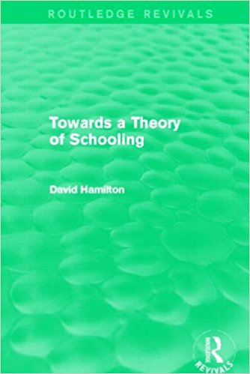
Towards a Theory of Schooling, (1989), example 1
Historical investigation of concepts such as ‘class’, ‘curriculum’ ‘classroom’, via intellectual genealogy, eg
  Class: from the University of Paris’ new Modus et Ordo Parisiensis (early 16th century) describing ‘sub-division of schools’ with ‘individualized pupil-by-pupil instruction’ (Hamilton, 7)
  It can refer either to sequence (eg of knowledge) or coherence (eg an ordered society) and re the second, see the new schools founded and patronized by mercantile classes, to provide
  a new knowledge for specialist mercantile activities, not church administration,
  and overseen by them.

Slide 40
Towards a Theory of Schooling, eg 2
  Curriculum – first used in English in 17th century records of University of Glasgow, in 1633 (OED) (Hamilton, 3).
  Context:
    introduced by Andrew Melville to create a specifically Calvinist mode of learning
    Used Ramist techniques of highly formalized teaching, with a knowledge plan that was rigid
    ‘the “whole life” of each student was to be rendered open to teacher supervision’ (Hamilton, 49)

Slide 41
Towards a Theory of Schooling, eg 2
‘First came the introduction of class divisions and closer pupil surveillance; and second came the refinement of pedagogic content and methods. The net result, however, was cumulative: teaching and learning became, for good or ill, more open to external scrutiny and control.’
(Hamilton 49)

Slide 42
Towards a Theory of Schooling, eg 3
  Classroom – first used in the context of Adam Smith’s professorial lectures in Glasgow University, including jurisprudence (1752-64)
    In education, Smith’s The Theory of Moral Sentiments is influential, where sympathy is an ethical & social bond (cf Francis Hutcheson’s concept of the moral sense faculty, akin to an aesthetic sense)
    Further developed by educators in and around Glasgow – David Stow, Robert Owen.
    A pedagogy was developed around sympathy and emulation (as self-esteem and self-improvement), not emulation and competition (as rivalry and conflict)

Slide 43
Why is this important to legal education?
Hamilton’s meticulous historical discourse analysis draws on generations of bibliographies into medieval, Renaissance, modern universities – historical and educational.
His work is an example of interdisciplinary work in other disciplines, eg Peter Galison’s ‘trading zone’, in atomic sciences, where multi-disciplines came together to work on projects
‘Slowly I began to appreciate that the weak sense of history shown by classroom researchers was matched only by the weak sense of the classroom shown by educational historians.’ (Hamilton, 2)

Slide 44
Where does this analysis happen in legal education?
Hamilton’s historical work is matched in Scots legal education by John Cairns and other researchers into 17th century & Enlightenment education in the law
Eg Cairns analyses of the shifts between Renaissance / Reformation pedagogies and Enlightenment pedagogies, together with the roles played by the judiciary (Lord Kames, for example) and philosophers (Smith, Ferguson)
Cairns, J. (1994). From ‘Speculative’ to ‘Practical’ Legal Education: The Decline of the Glasgow Law School, 1801-1830. Tijdschrift voor Rechtsgeschiedenis, 62(3), 331-56.

Slide 45
But what about the modern period?
Textbooks are plentiful but…
No single history of legal education in the modern period
No sense of sustained innovation in methods
Schon’s ‘dynamic conservatism’ is at work in innovation?
Some sense of a specifically Scottish approach to legal education, but weakly if at all articulated in law schools
No discourse analysis, no renewal of traditions in, eg, democratic education, moral philosophy
No sustained, longitudinal effort to map the field, create taxonomies, tag-structures, etc

Slide 46

We have almost no disciplinary memory of our technology in legal education…
There are no histories, one bibliography (Goldman, 2008), no collective statements, few policy papers, no map of interdisciplinary collaborations, no meta-reviews, few discourse analyses of the field (none updated). In the UK, we have three BILETA Reports (1991, 1996, 2004). One systematic review: Maharg, P., Nicol, E.
(2014).
Cp with the complex cultures of research summaries and meta-reviews in medical education, with whole websites devoted
to the collation of massive volumes
of research, eg Cochran Collaboration

Slide 47
4. University differences within the UK settlement: QAA vs enhancement

Slide 48
Initial impetus for change
Scotland at first followed the QA model of the rest of the UK from the early nineties then, in 2003, following dissatisfaction with this model from institutions (stemming from bureaucratic managerialism, and the resulting conflict between quality rhetoric and academic discourse), developed its own model of the Quality Enhancement Framework

Slide 49
What is the Quality Enhancement Framework ?
This model is:
based upon the concept of enhancement-led quality assurance, where institutions reviewed their practices and cultures in a process that was much more student-centred (with students actively engaged as part of the process, rather than simply respondent-fodder)
focused on the longer-term of institutional improvement
emphasised reflection and improvement for the future

Slide 50
What is the Quality Enhancement Framework ?
Ownership and legitimation of the process of review was seen as critical to the process of shifting from audit-policy cycles to improvement cycles.
the process emphasised self-review though a process called ELIR (Enhancement-Led Institutional Review)

Slide 51
Lancaster University team review comment
‘[t]his enabled a familiarity, an ownership and a legitimation that other forms of implementation strategy might find hard to emulate. We term this a theory of “consensual development”’

Slide 52
What is to be done?
Possible ways forward:
Collaborative writing & project work within Scotland along rhizomatic lines
Collaboration beyond the jurisdiction (SIMple is an example of this)
Collaboration of institutions within our small jurisdiction (eg GGSL)
Network of small jurisdictions across a region – LENA
Reshape our traditions, renew our history by shaping it anew

Slide 53
POTENTIAL APPLICATIONS AND IMPLICATIONS
Doctrinal analysis
Socio‑legal inquiry
Policy and pedagogy
Notes:
5. POTENTIAL APPLICATIONS AND IMPLICATIONS
A. Dcctrinal analysis
Rhizomatic cartography can trace how doctrinal content travels through translation, transplantation or irritation (Watson 1993; Teubner 1998). For instance, corporate‑governance norms migrate to offshore centres, where they hybridise with local trust law and create curricula that challenge doctrinal purity.
B. Cocio‑legal inquiry
Socio‑legal scholars may deploy the framework to examine how power relations shape professional identity, access to justice and curricular reform in under‑researched settings (Salaymeh & Michaels 2022). Mapping assemblages reveals who is authorised to define ‘professional competence’ and whose epistemologies remain marginalised.
C. Policy and pedagogy
Policymakers could use rhizomatic mapping to design collaborative accreditation schemes that pool resources among small jurisdictions, while educators can leverage the framework to scaffold trans‑systemic learning experiences (Kasirer 2003). Digital platforms make it feasible to co‑teach modules across time zones, enacting the rhizome’s principle that any point can connect to any other.

Slide 54
Contribution to scholarship
Re‑centring small jurisdictions within comparative debates, challenging scale‑biased hierarchies;
Operationalising rhizomatic mapping as a portable methodology that integrates doctrinal, conceptual and socio‑legal perspectives; and
Demonstrating how size‑sensitive, assemblage‑based comparison can inform broader discussions on decolonisation, digitalisation and professional ethics in legal education.

